Slide 1
Machine Learning INET
Fall 2024

Slide 2
Today
Bayesian Learning
a probabilistic approach to machine learning that relies on Bayes' theorem
Naive Bayes
a classification algorithm that applies Bayes' theorem with the naive assumption that features are conditionally independent given the class

Slide 3
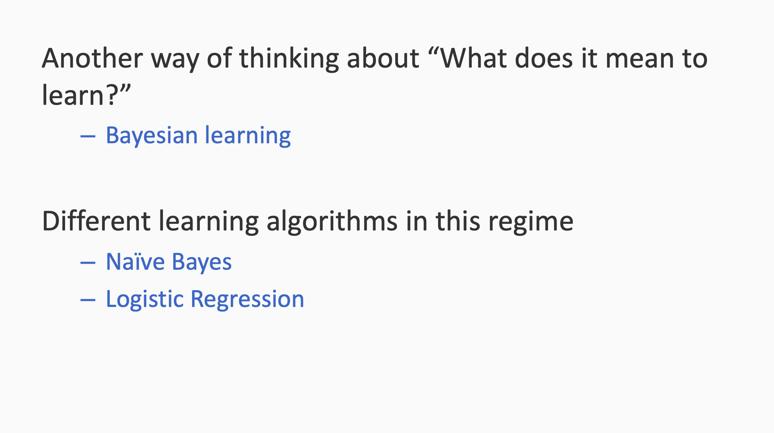
Bayesian Learning

Slide 4
Bayesian Learning
Bayesian Learning:
Use of a probabilistic criterion in selecting a hypothesis
The hypothesis can be deterministic, a Boolean function (e.g. W^{T}x)
The criterion for selecting the hypothesis is probabilistic

Slide 5
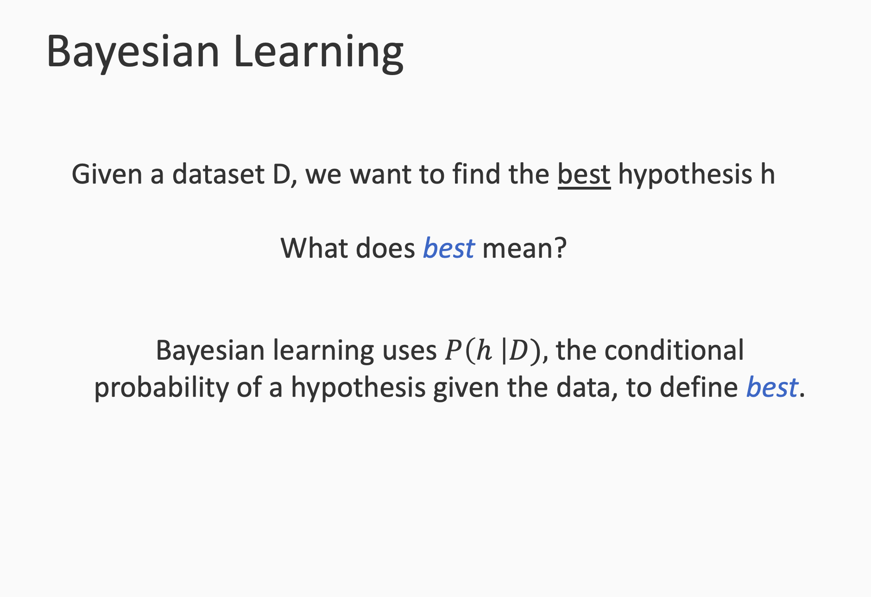

Slide 6
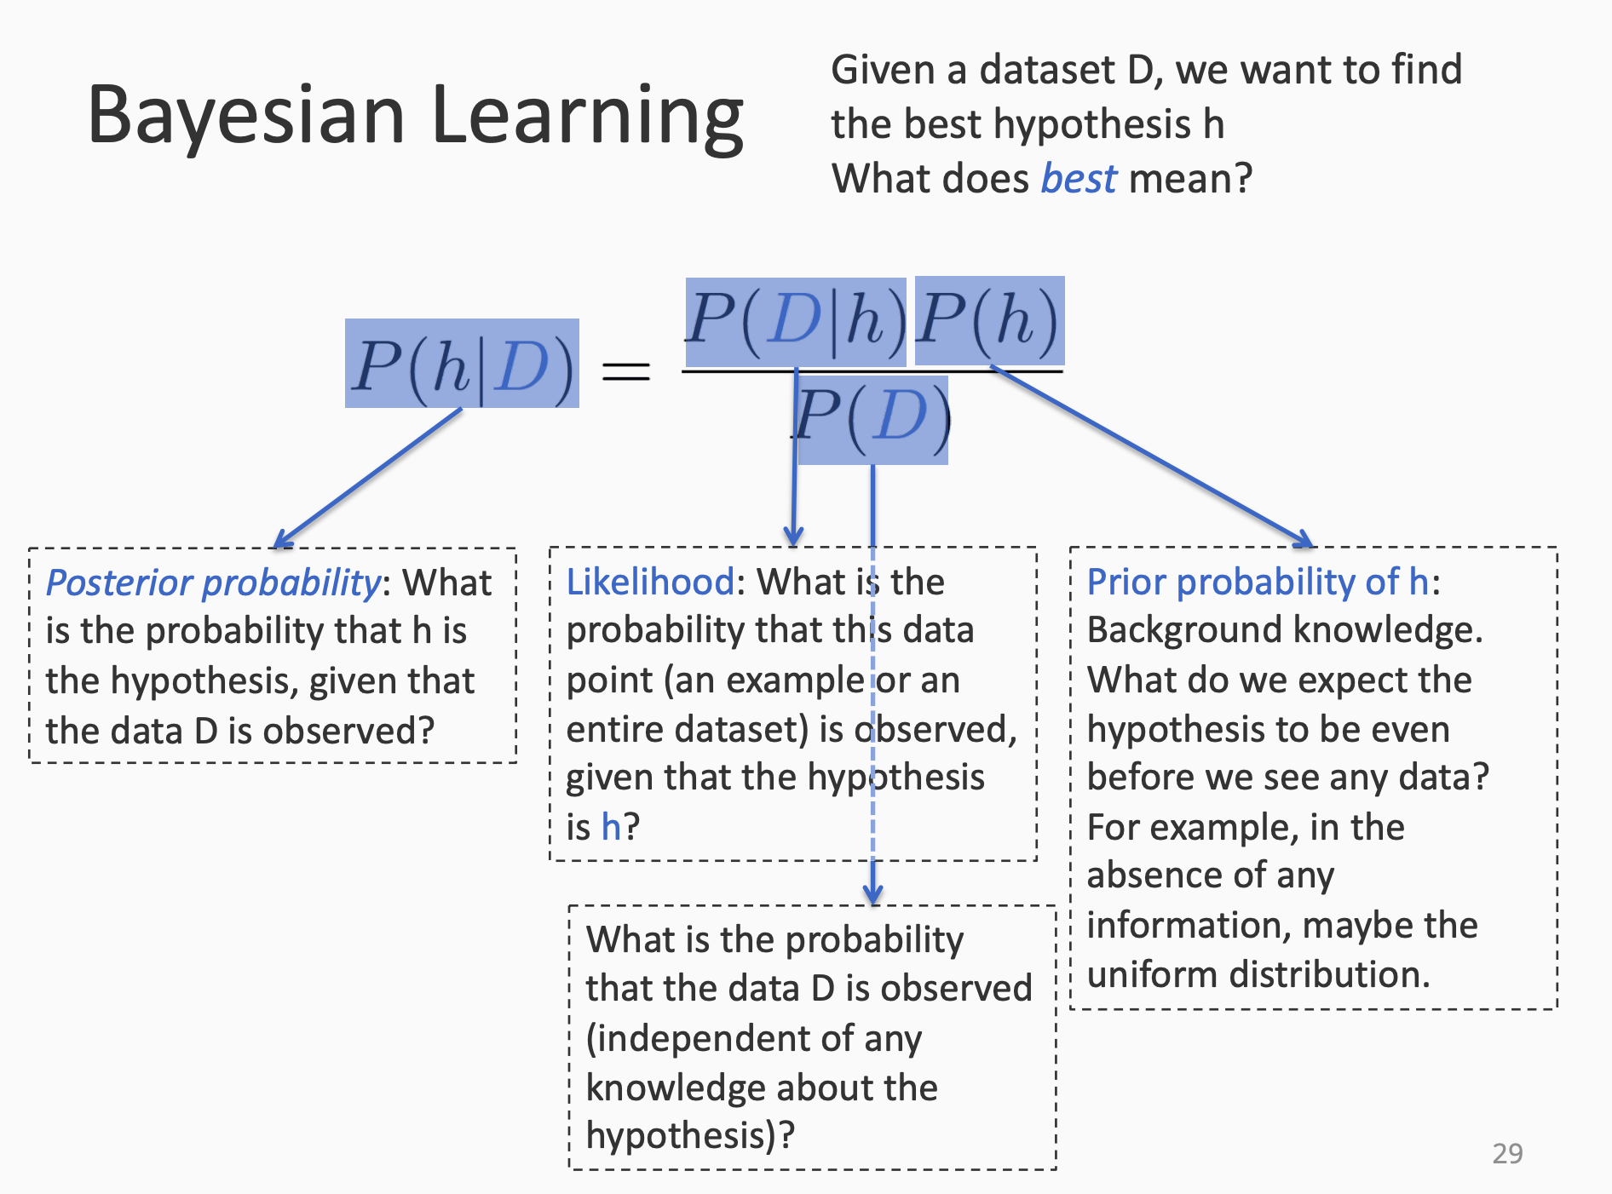


Slide 7
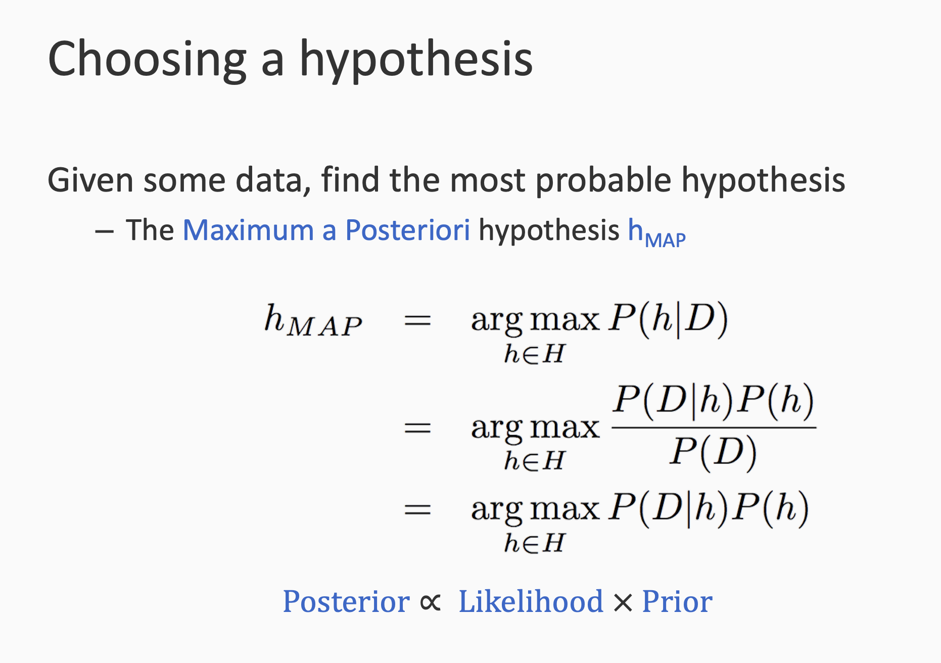

Slide 8
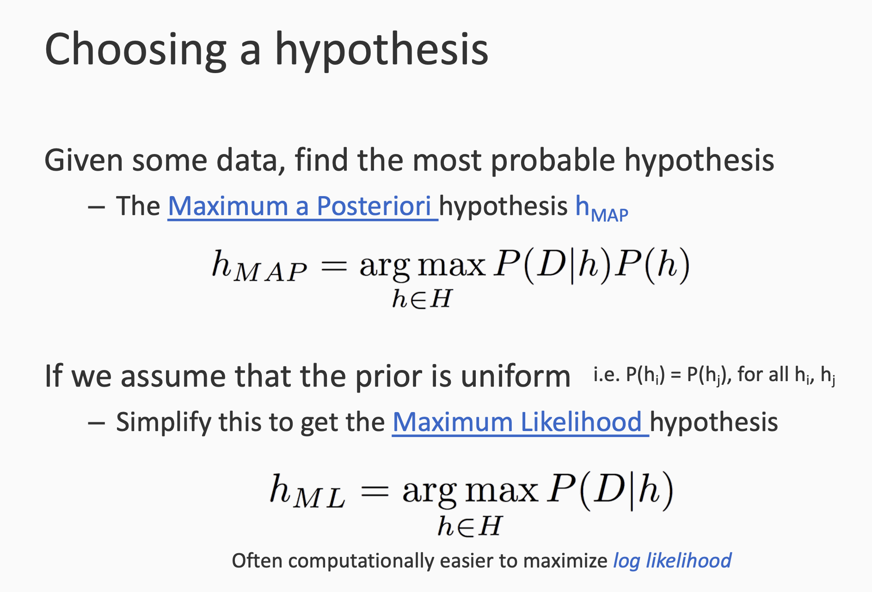

Slide 9


Slide 10
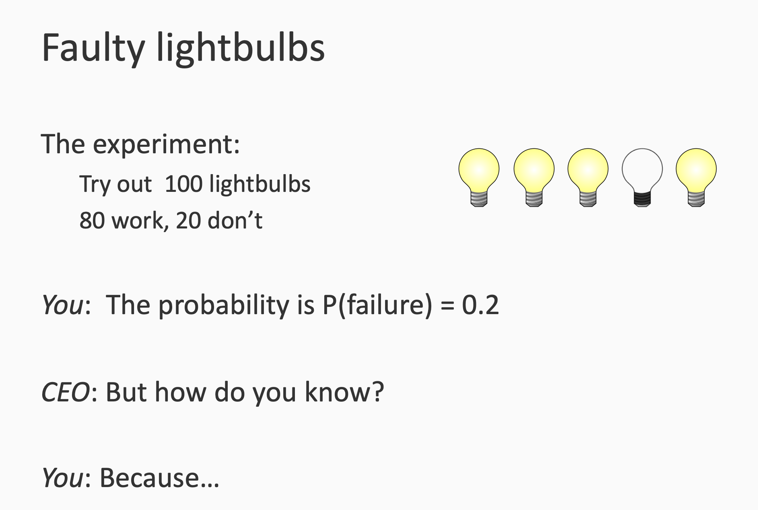

Slide 11
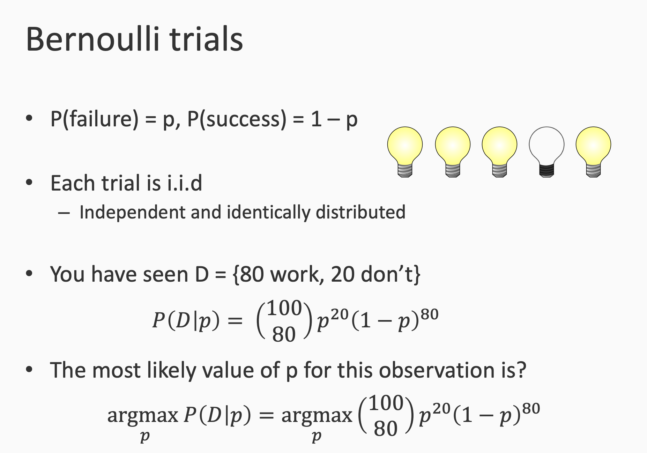
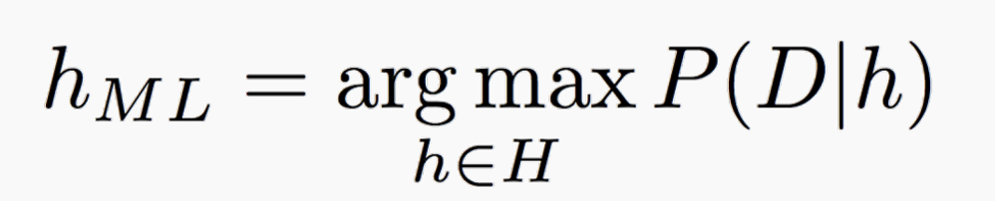

Slide 12
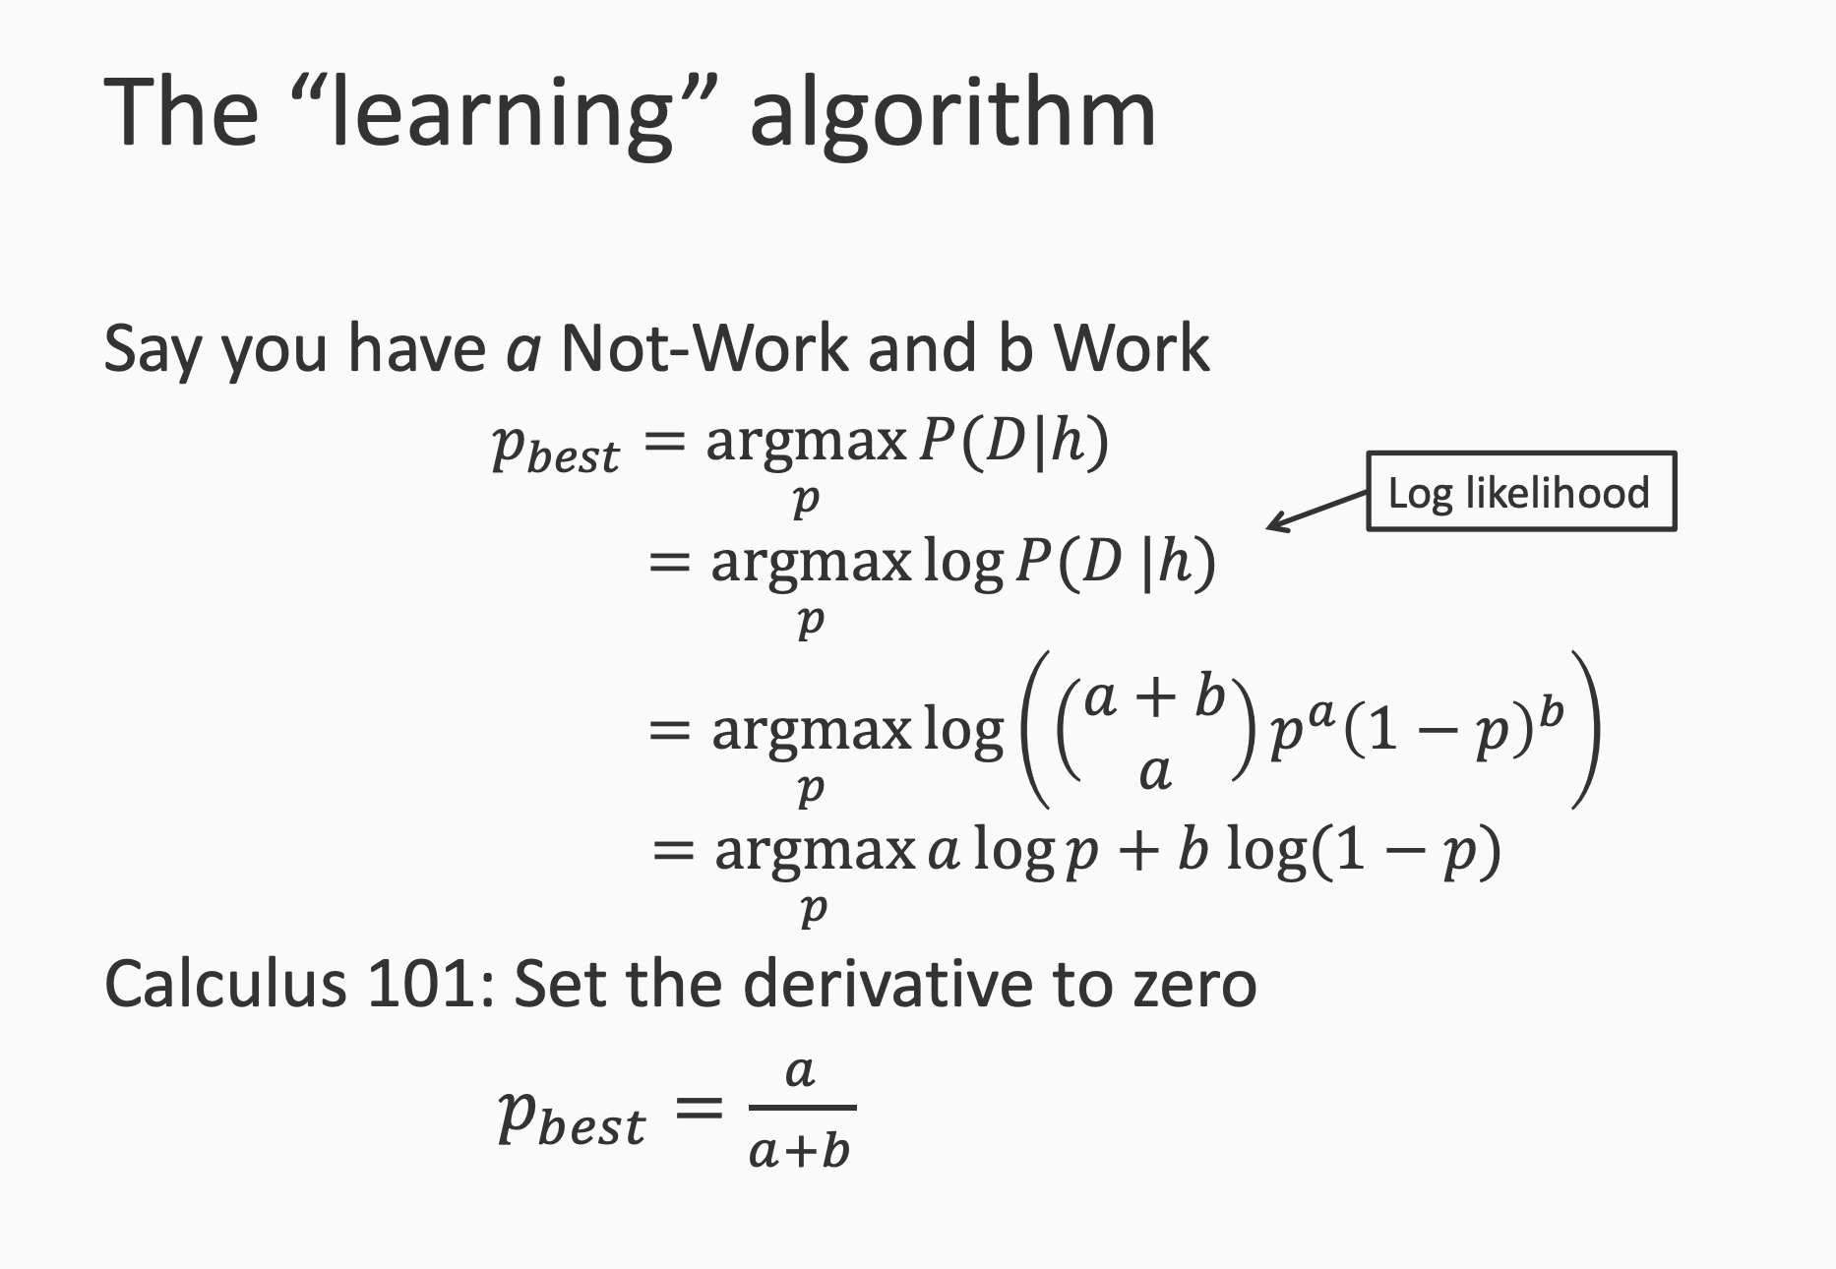

Slide 13
Bayesian Learning
Probabilistic approach towards ML
MLE
MAP
h* = argmax P(h|D) = argmax P(D|h) P(h)
In MLE: h* = argmax P(D|h) → because P(h) is uniform
In MAP: h* = argmax P(D|h) P(h)

Slide 14
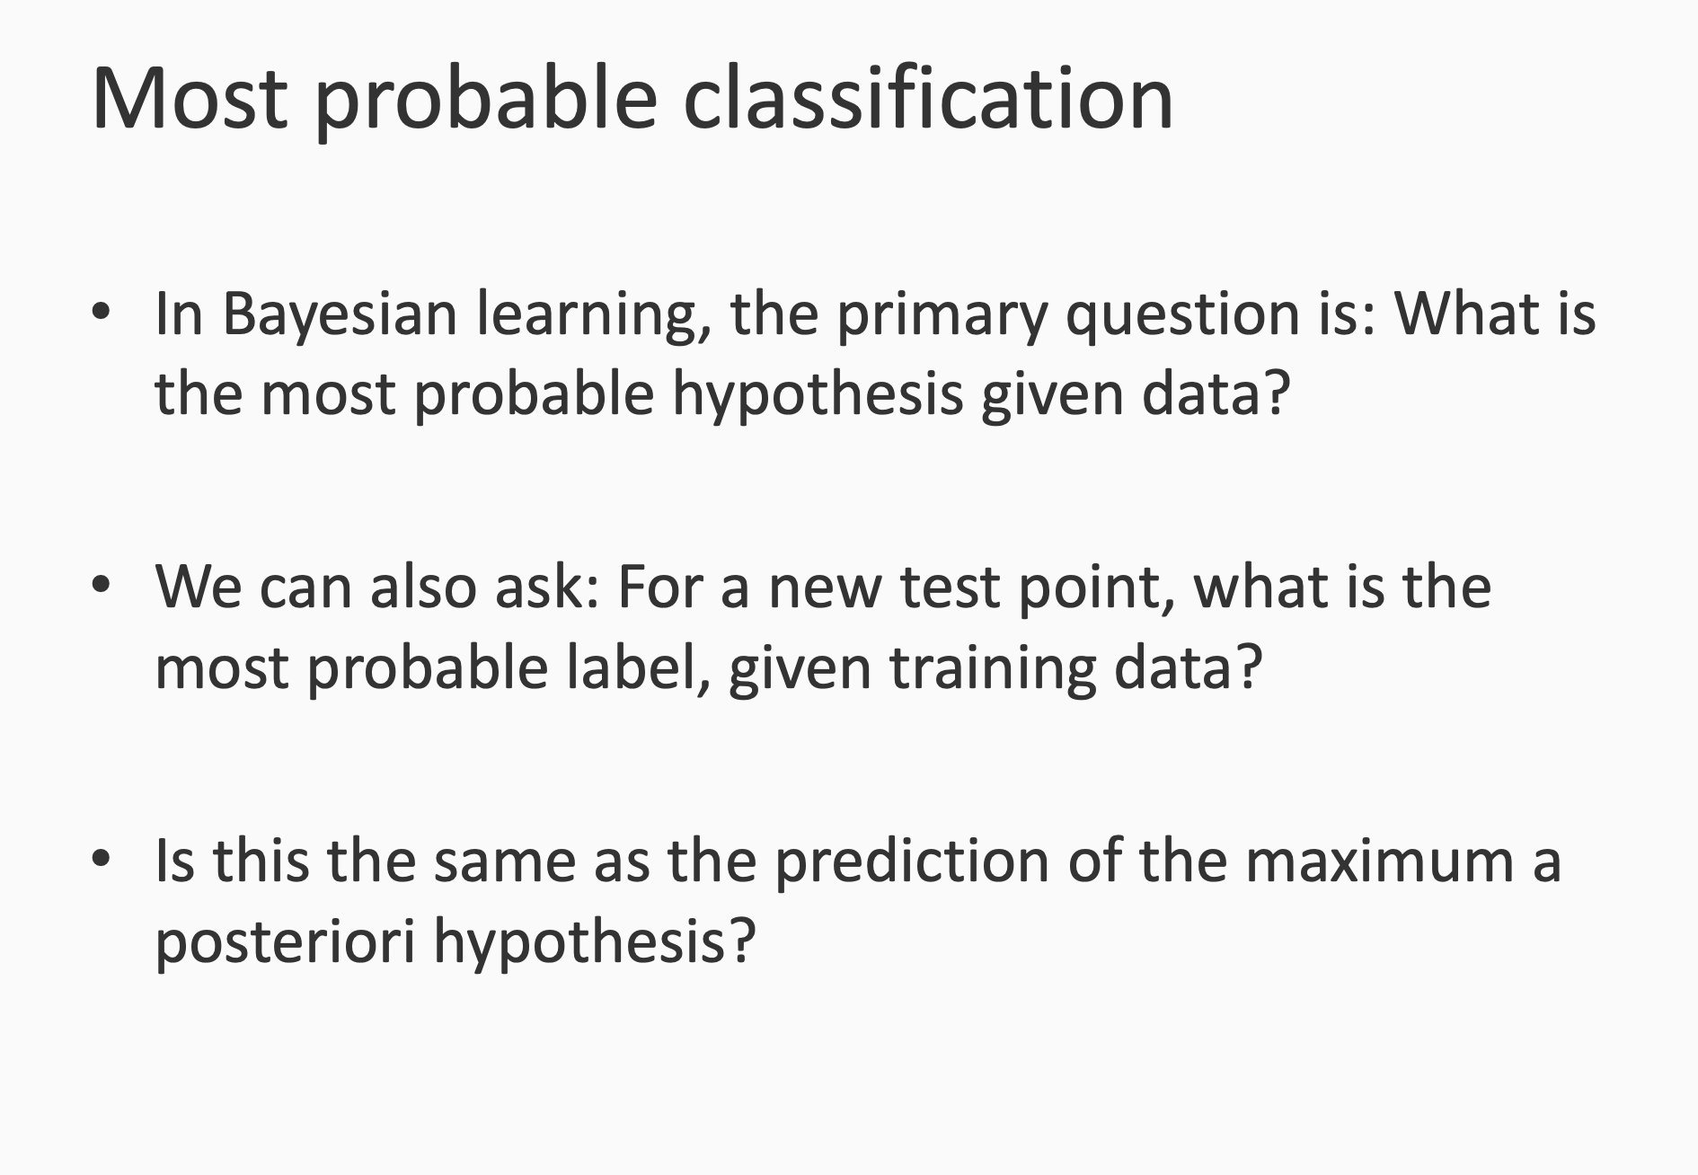

Slide 15
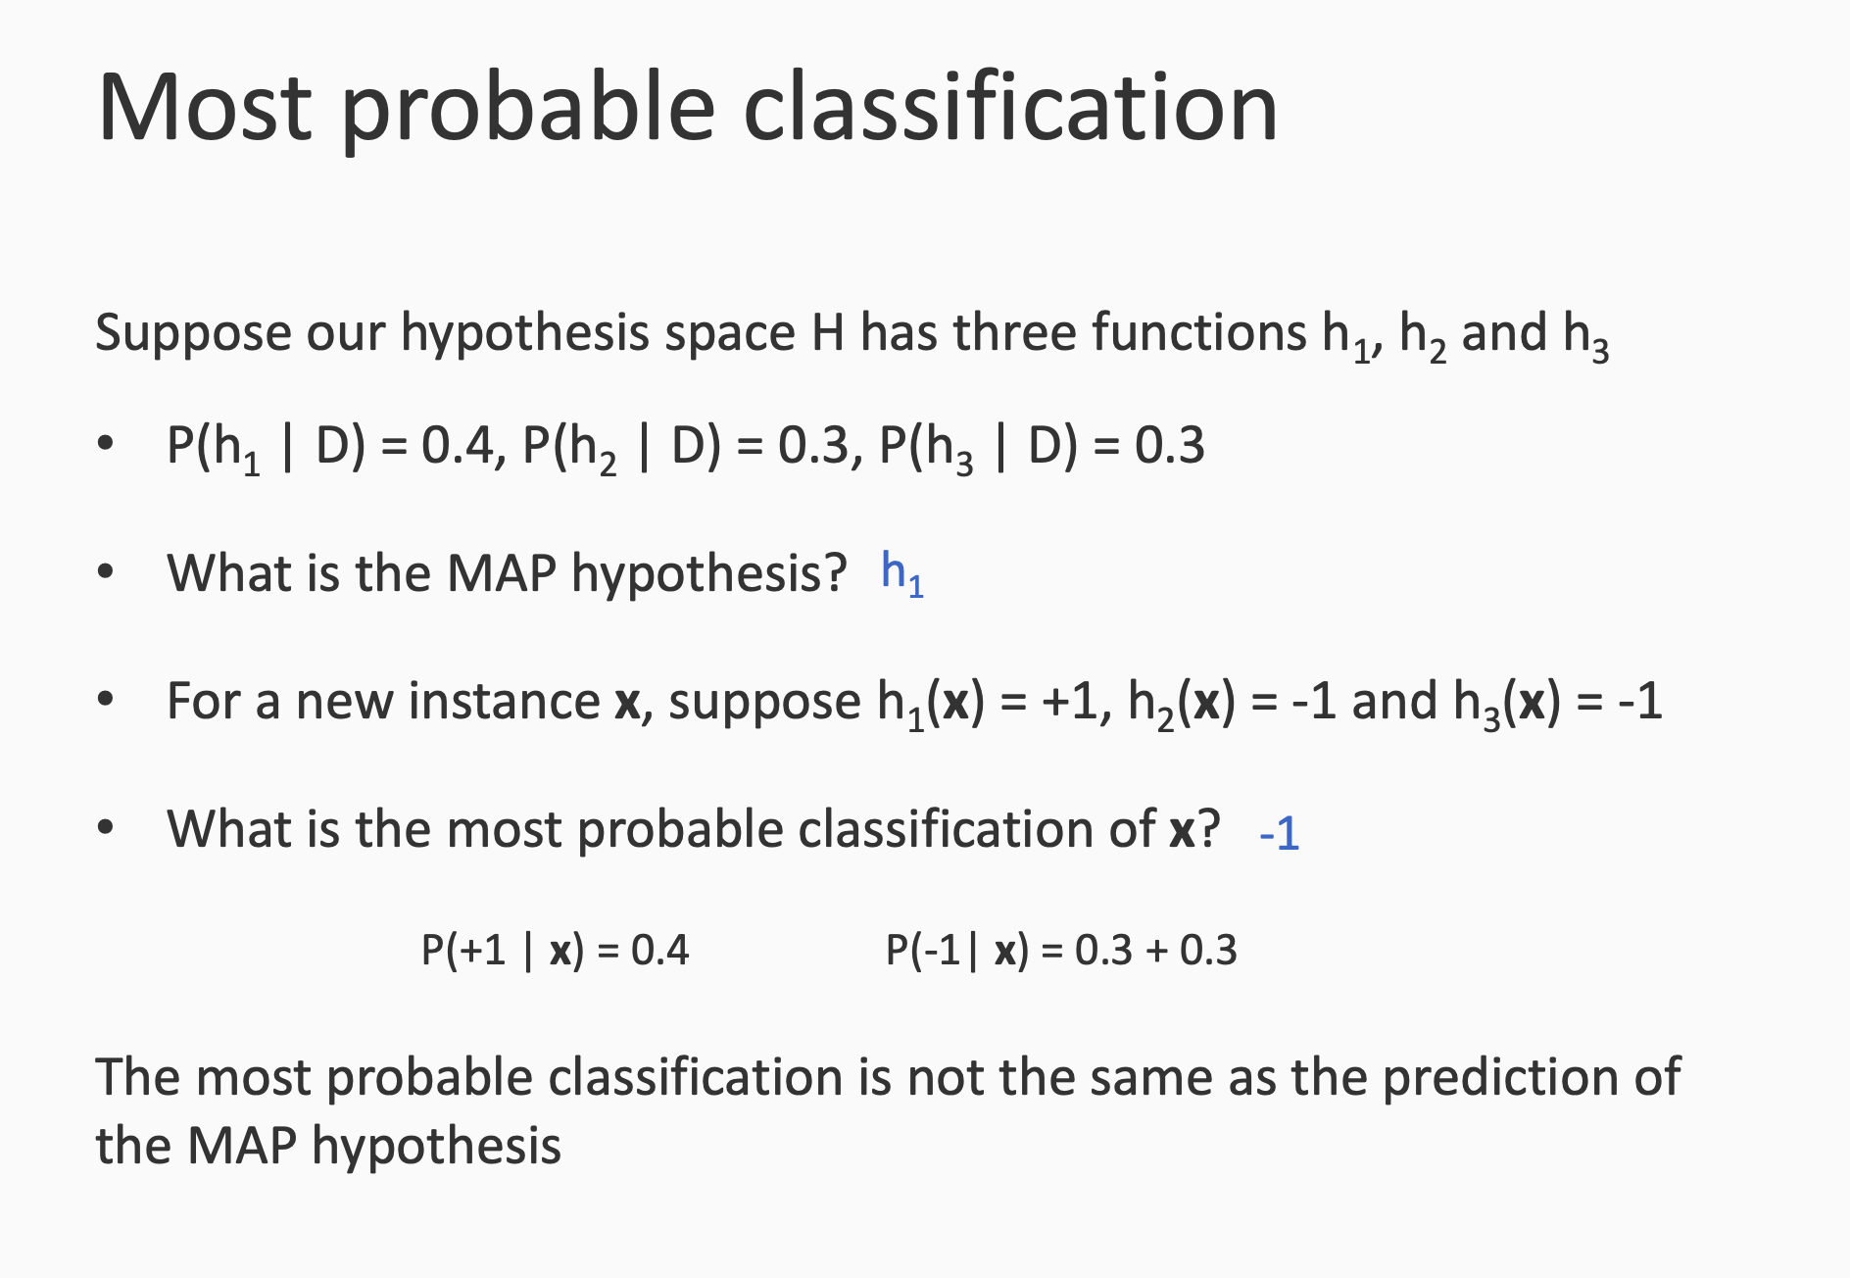

Slide 16
Maximum a posteriori (MAP) prediction

Slide 17
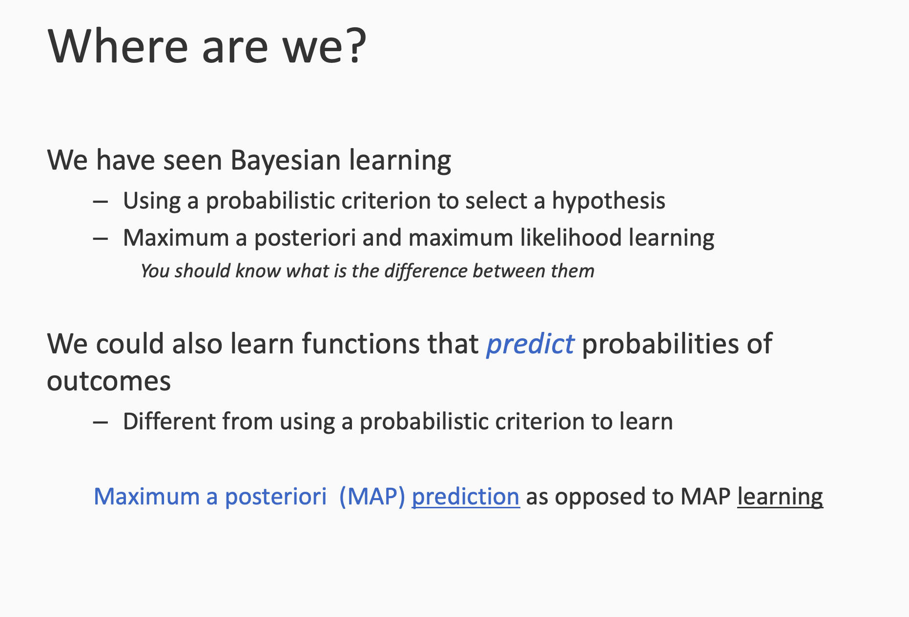

Slide 18
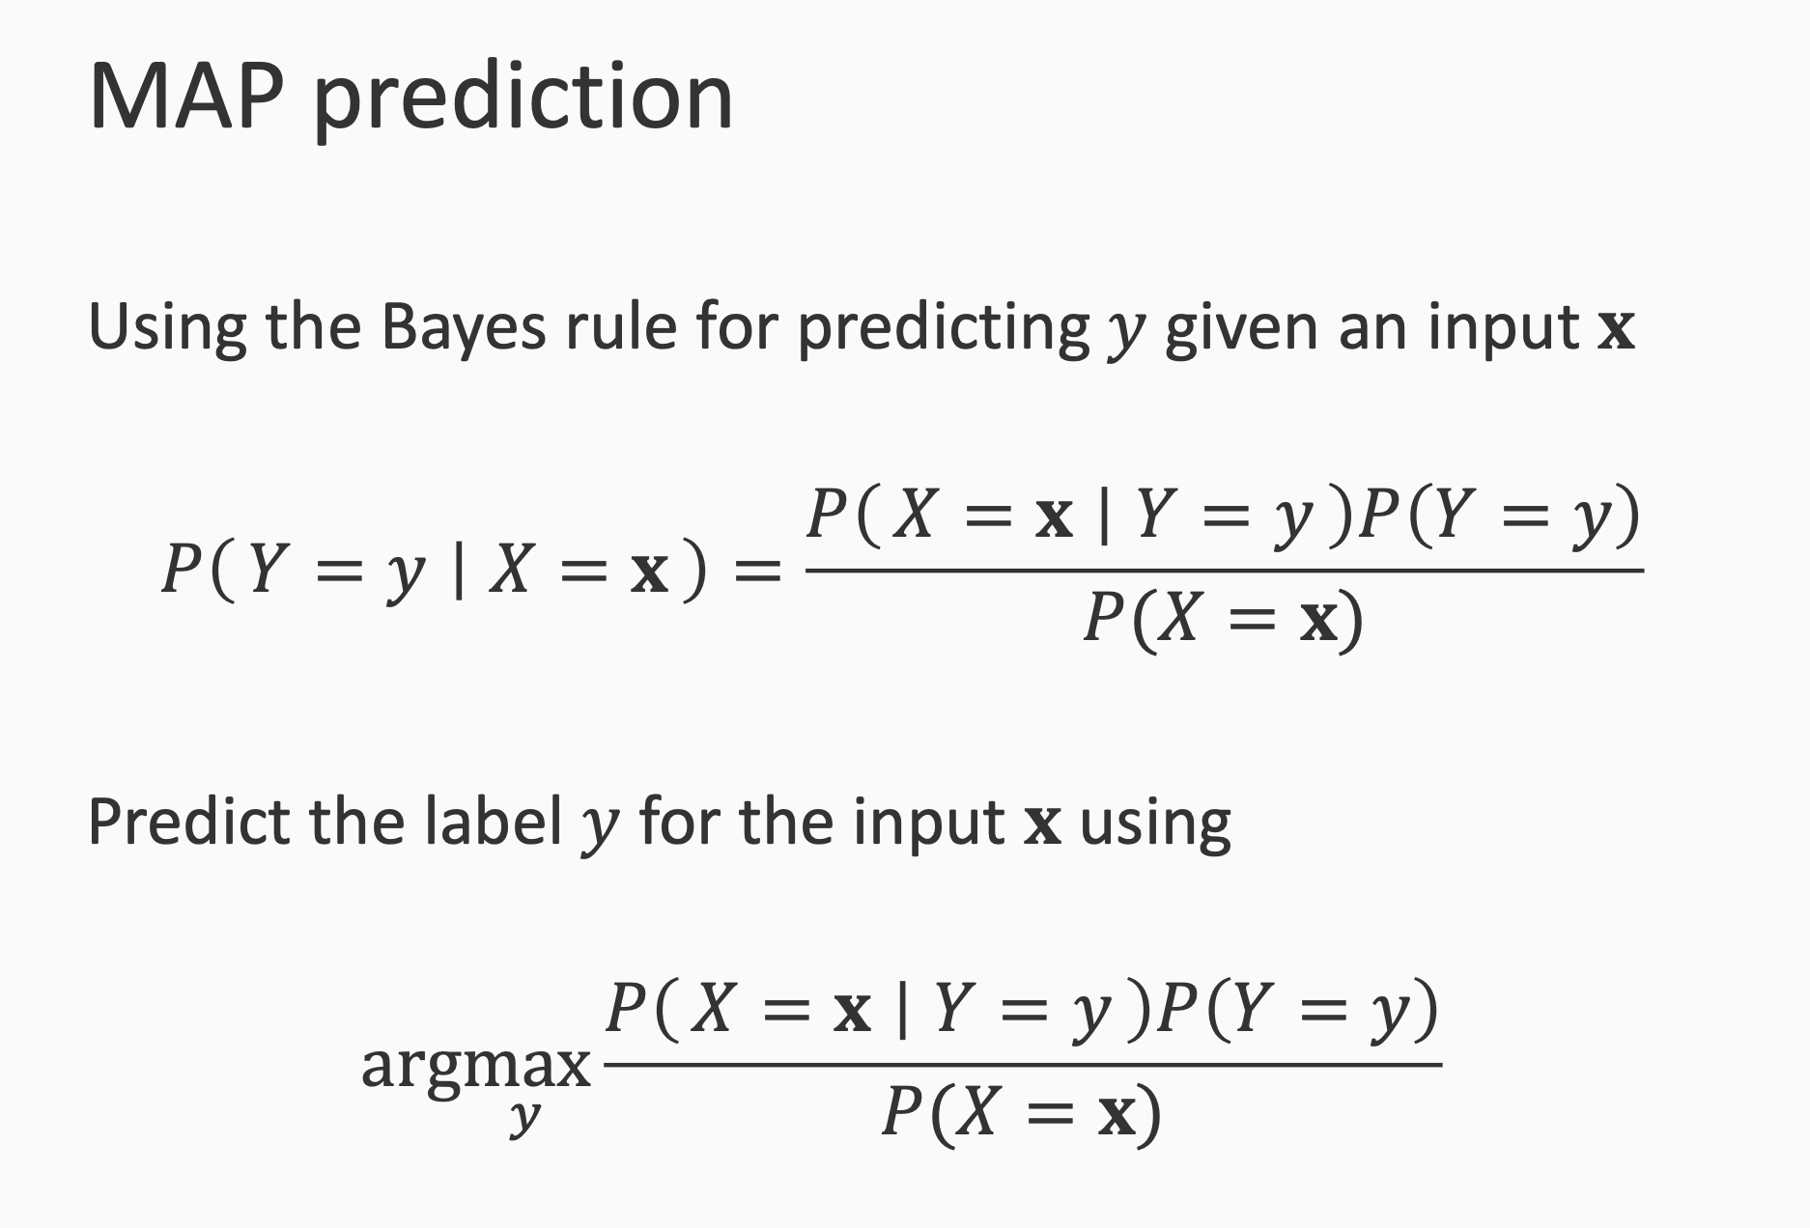

Slide 19
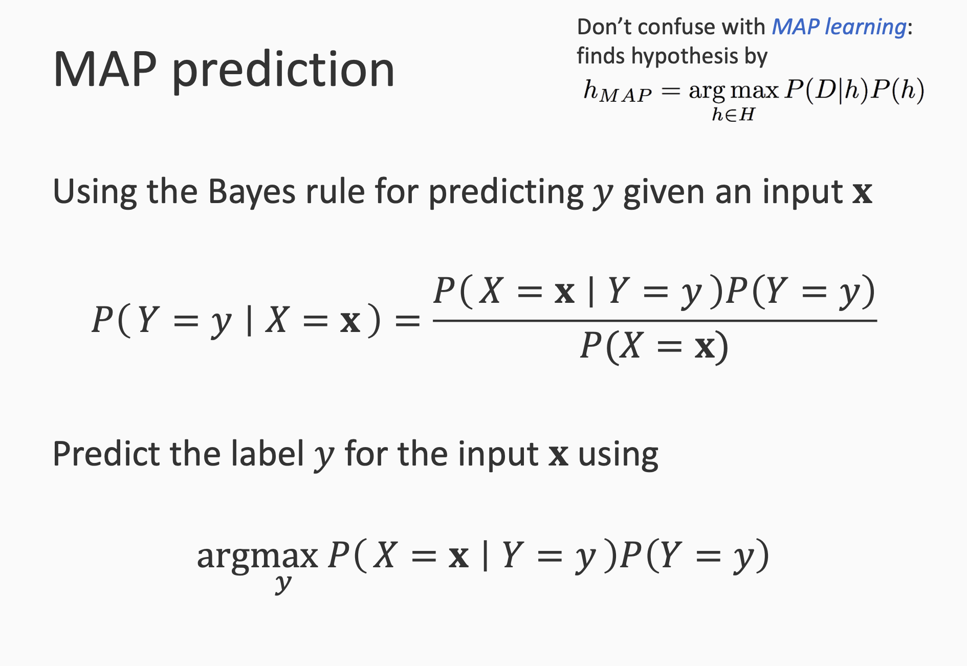

Slide 20
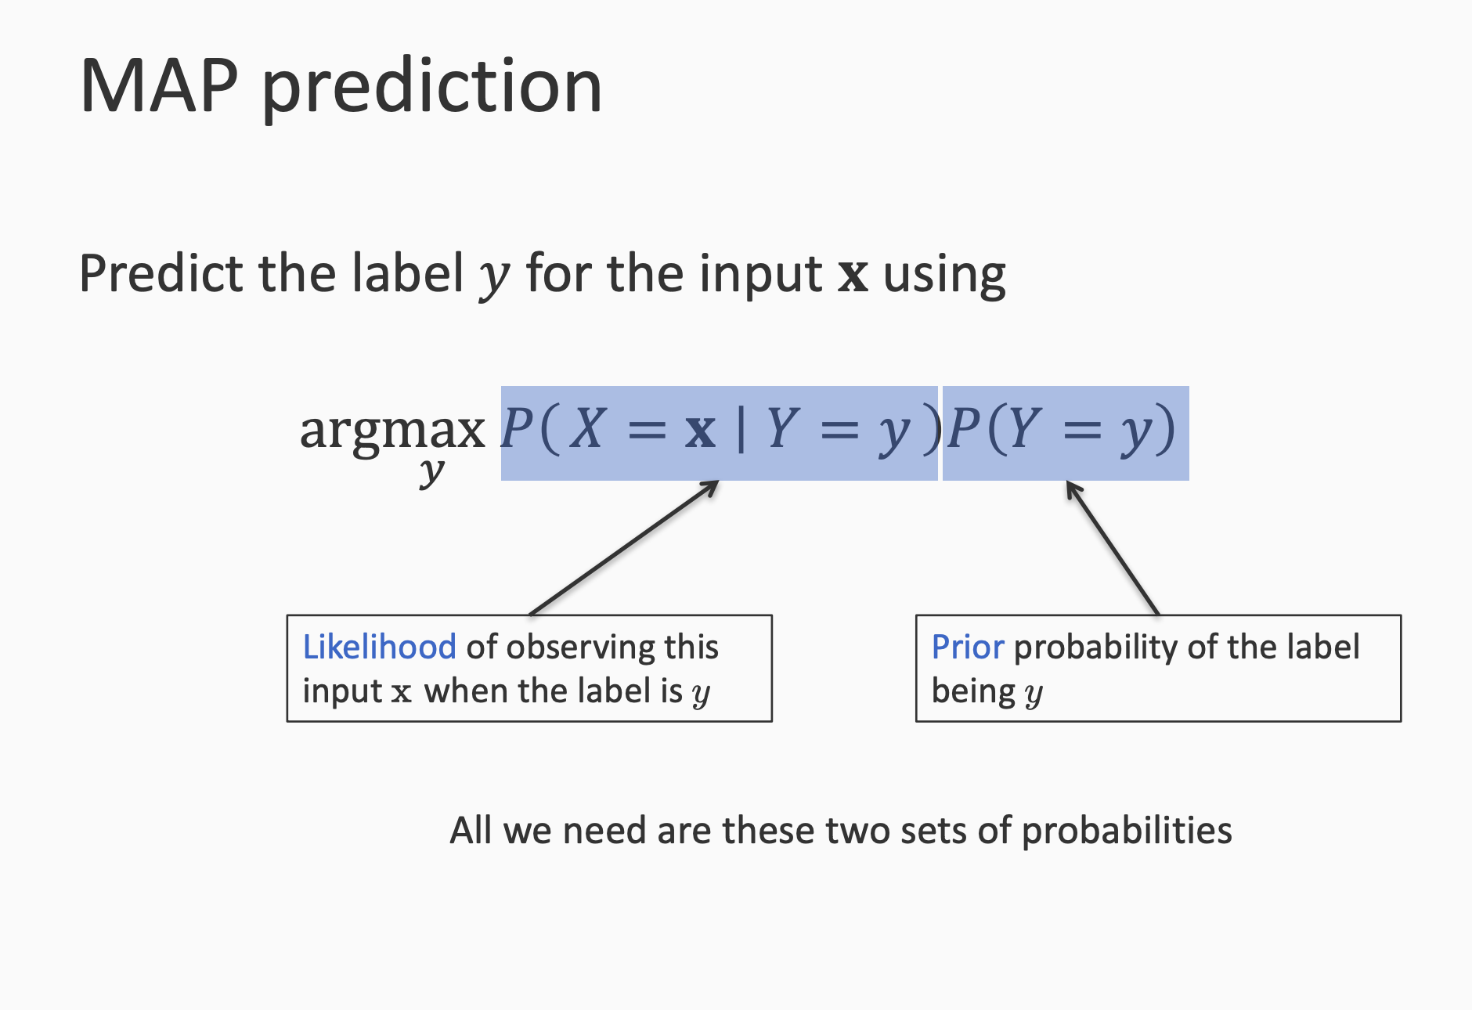

Slide 21
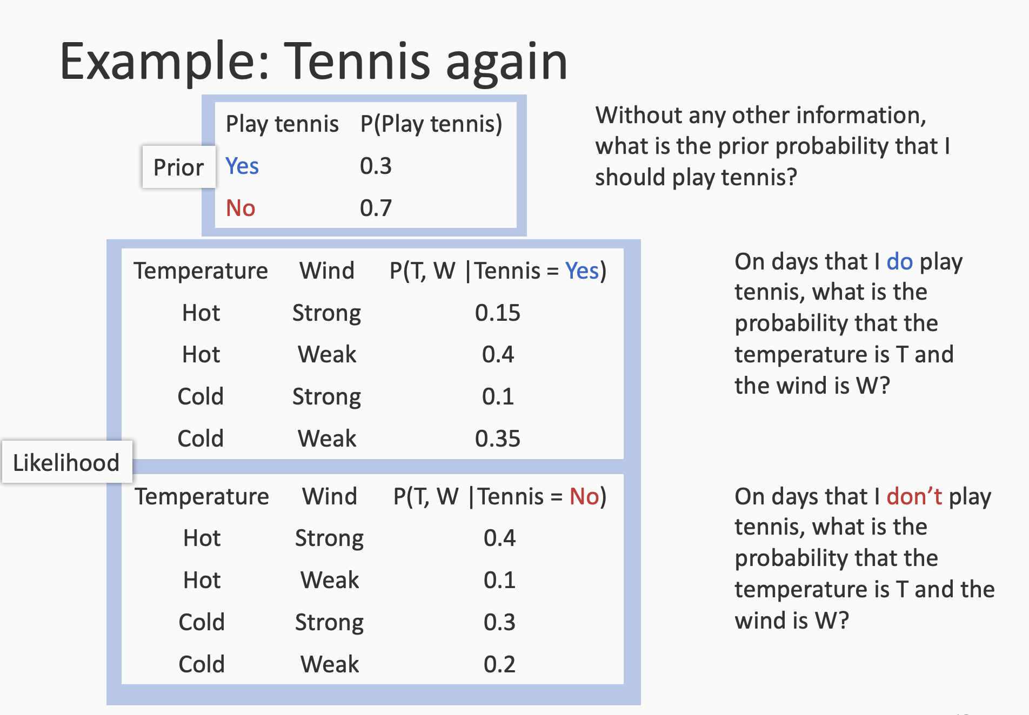

Slide 22
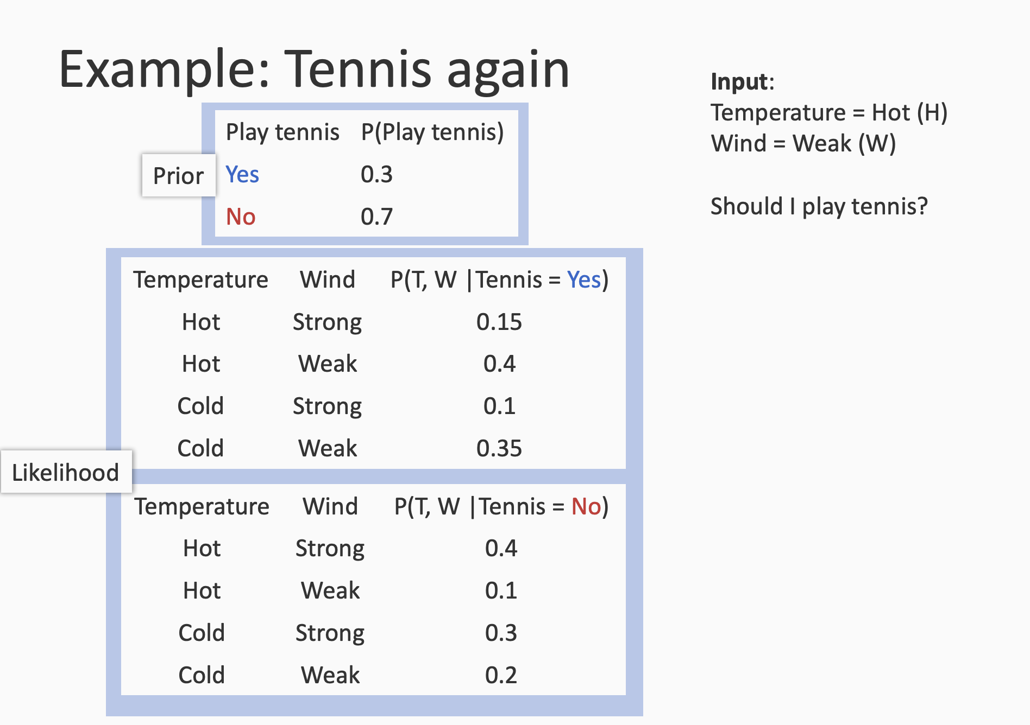
Posterior: P(play=yes|hot, weak) =
P(hot,weak|play=yes) . p(play=yes) =
0.4 * 0.3 = 0.12
Posterior ~ likelihood. Prior ← bayes rule
P(play=no|hot, weak)=
P(hot,weak|play=no) . p(play=no) =
0.1 * 0.7 = 0.07
MAP prediction is play=yes

Slide 23
Bayesian learning : an umbrella term. A regime in learning
Bayes rule: p(y|x) = p(x|y)p(y)/P(x)
Naive bayes: classification algorithm based on bayesian learning and uses bayes rule

Slide 24
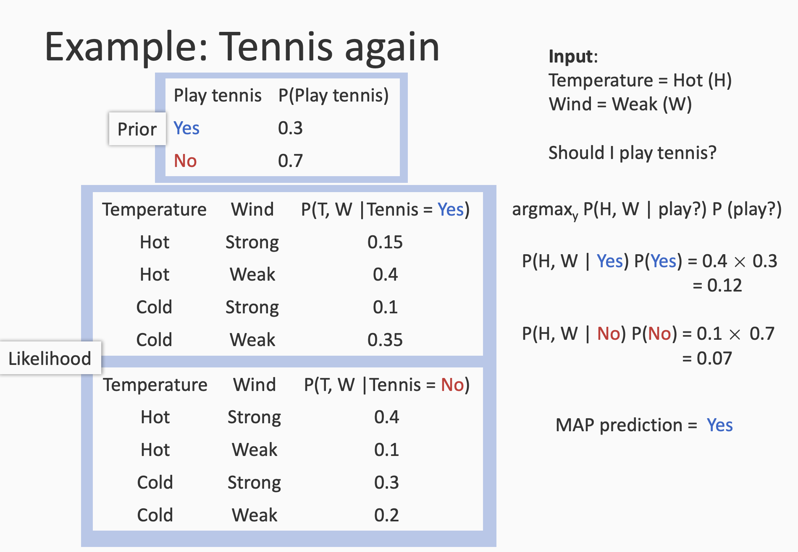

Slide 25
How hard is it to learn probabilistic models?

Slide 26
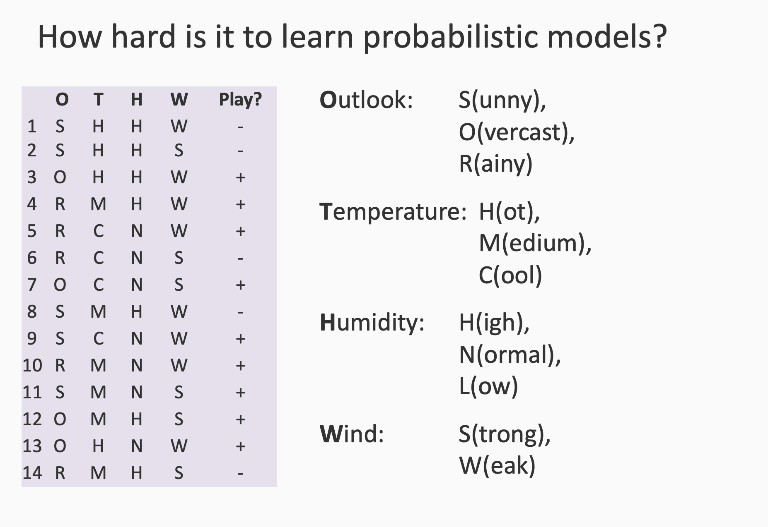

Slide 27
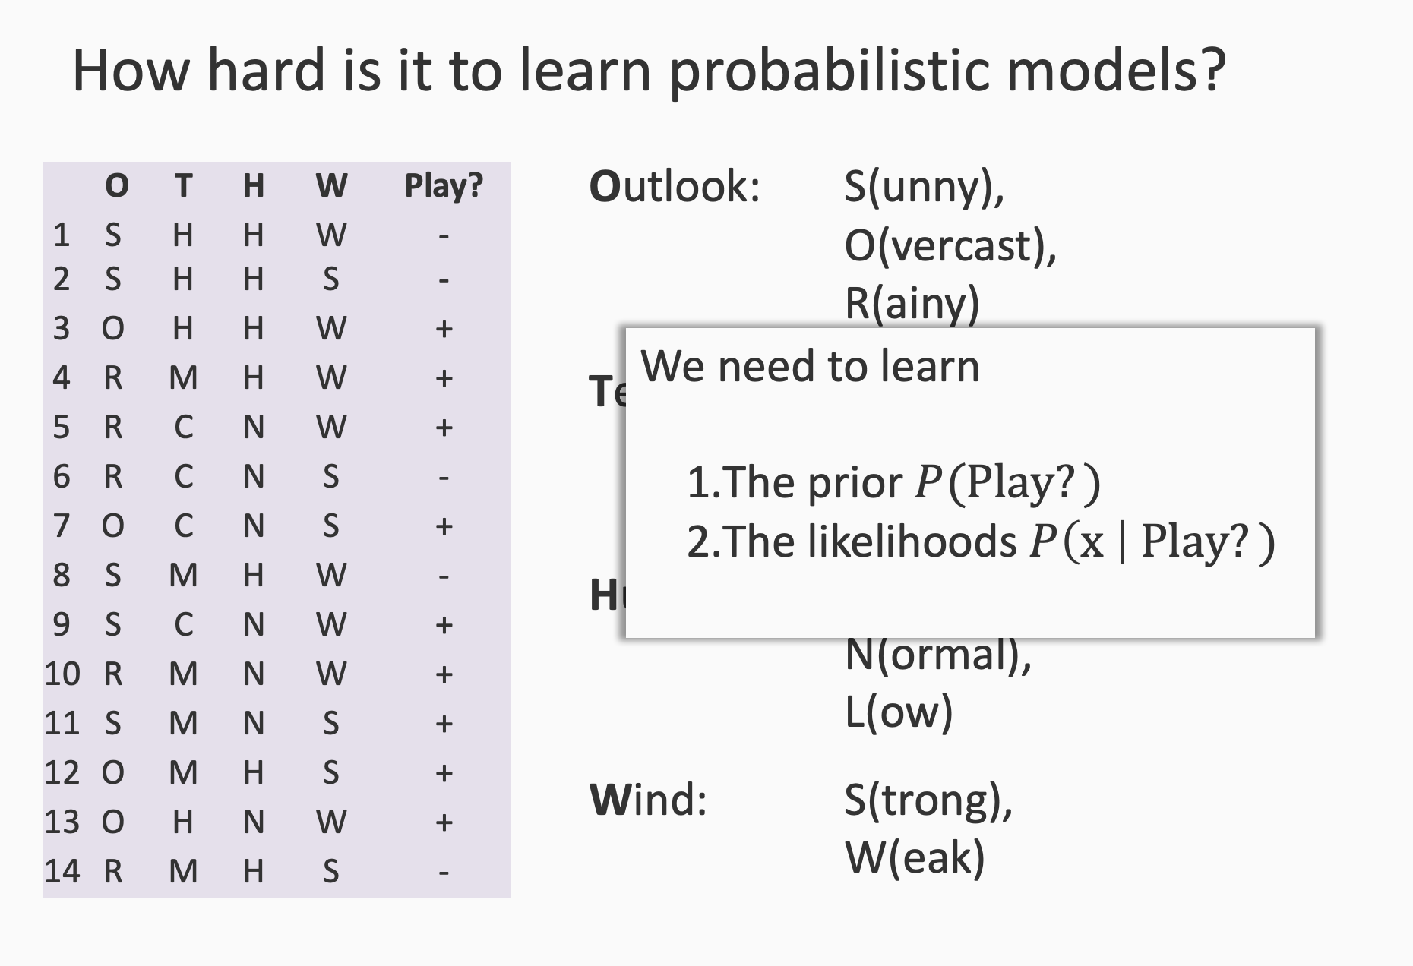

Slide 28
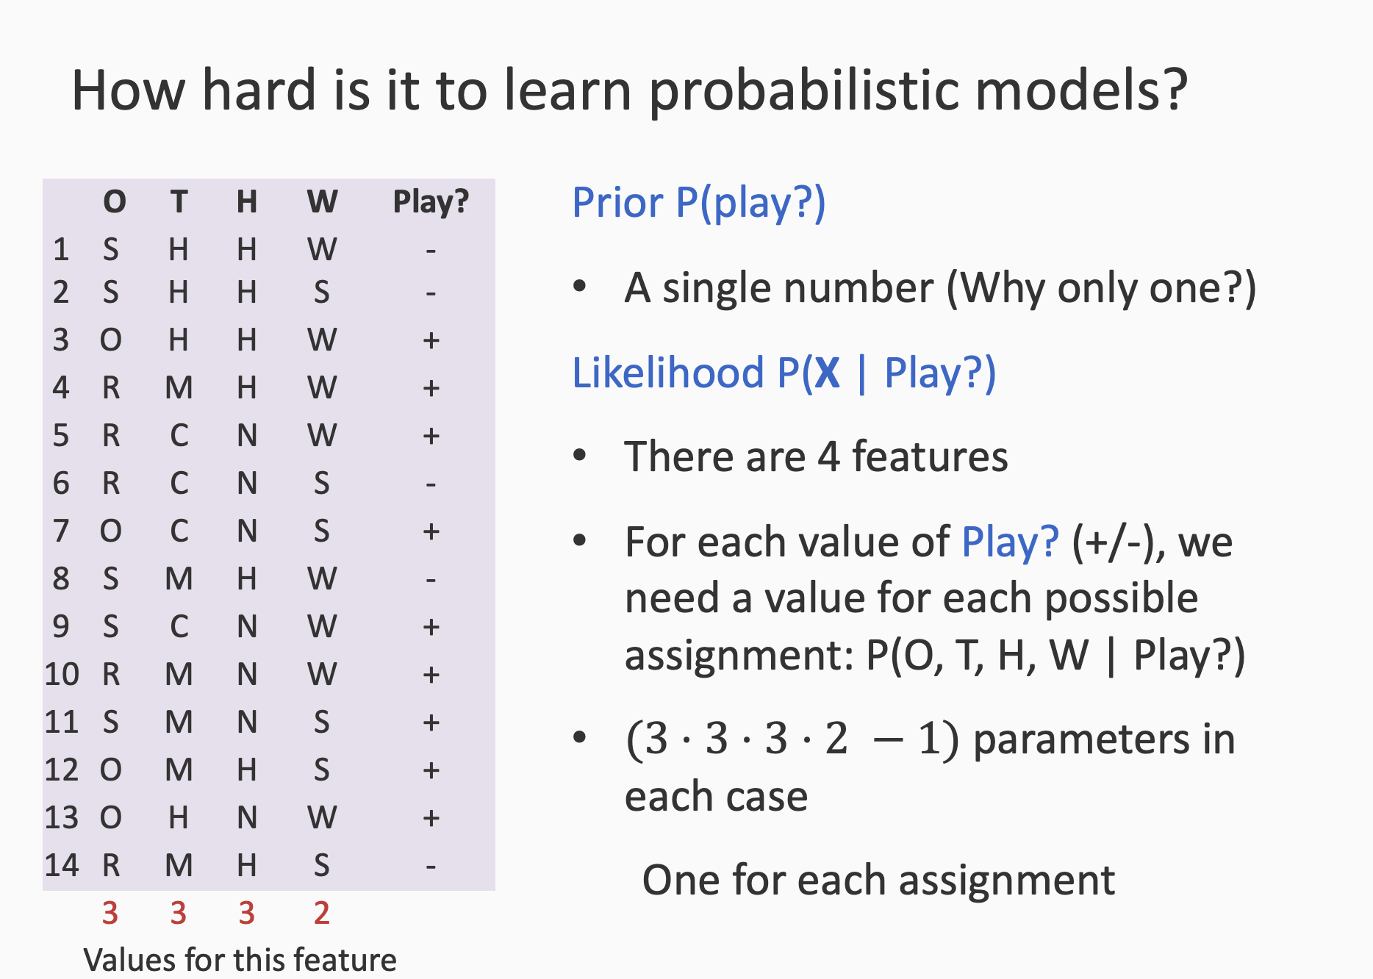

Slide 29
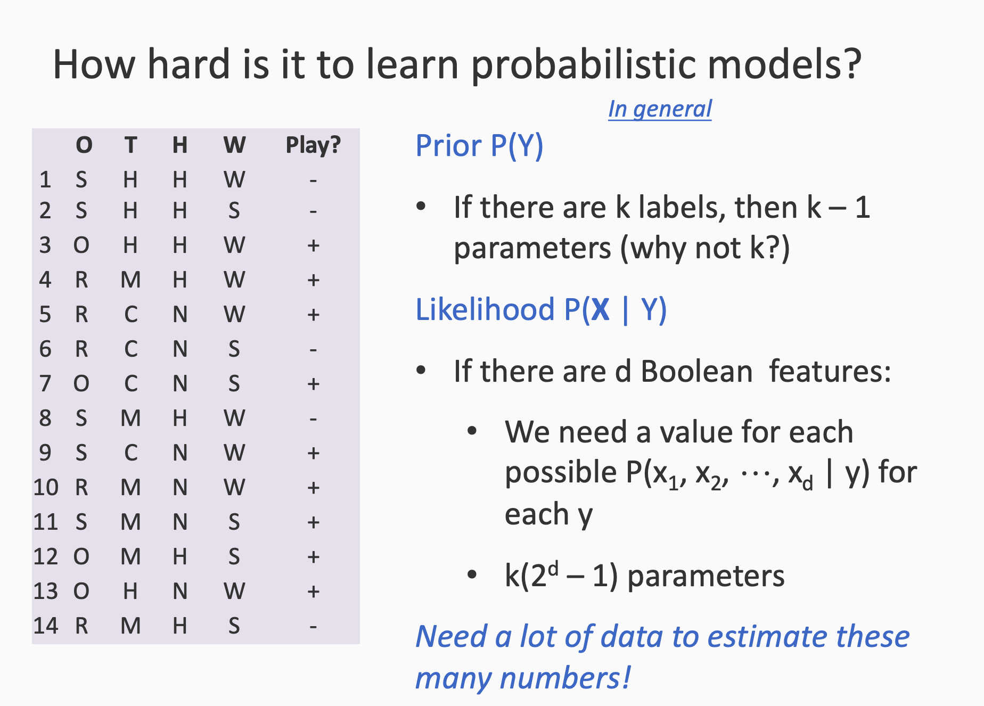

Slide 30
How can we deal with this?
Make independence assumptions

Slide 31
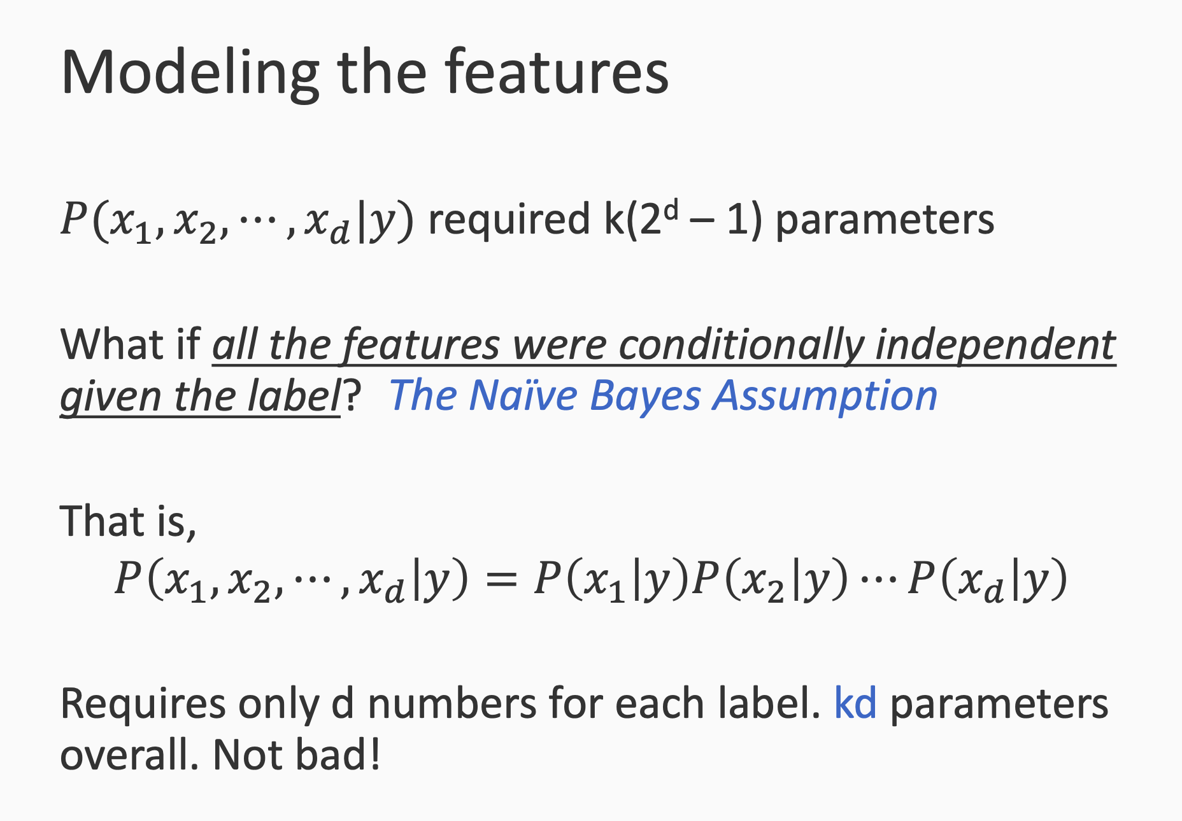

Slide 32
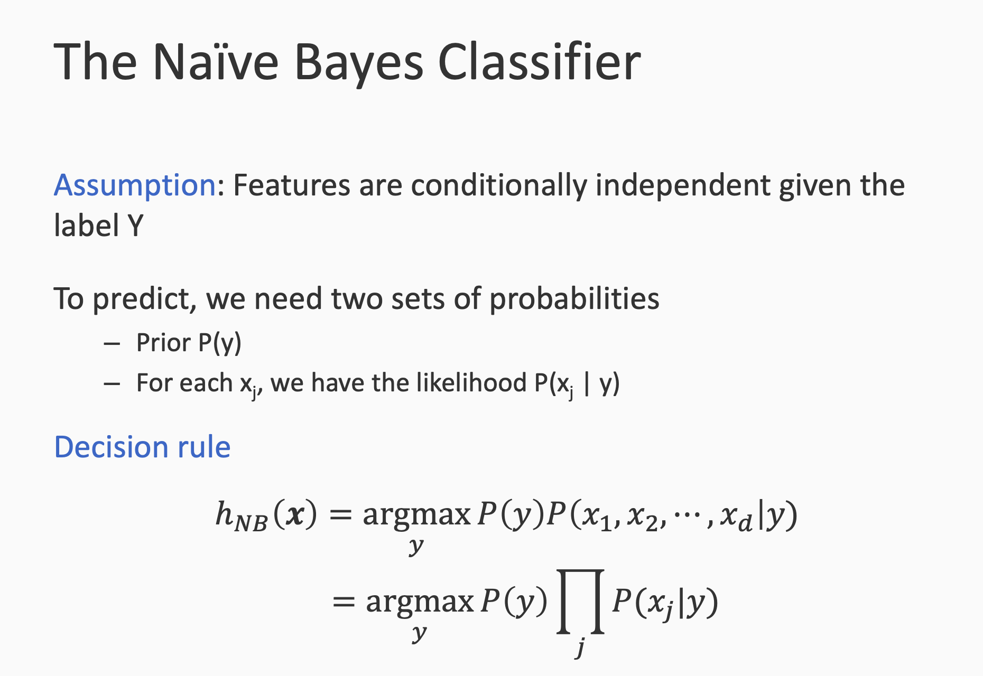
Goal: for a given data point x, predict the label using naive bayes

Slide 33
Two assumptions
i.i.d dataset -> P(D) = P(x1).P(x2)....P(x100)
Independent features -> P(x) = P(x₁). P(x₂).... P(x₁₀₀₀)

Slide 34
Naive assumption
Naive bayes takes a naive assumption that features are indpt
Data: is about housing
Feature: area, #bedrooms, #bathrooms, #neighborhood, etc.
Target: price
All features are independent from each other
It uses MAP, or ML to find the best prediction (MAP prediction)

Slide 35
Learning the Naive Bayes Classifier

Slide 36
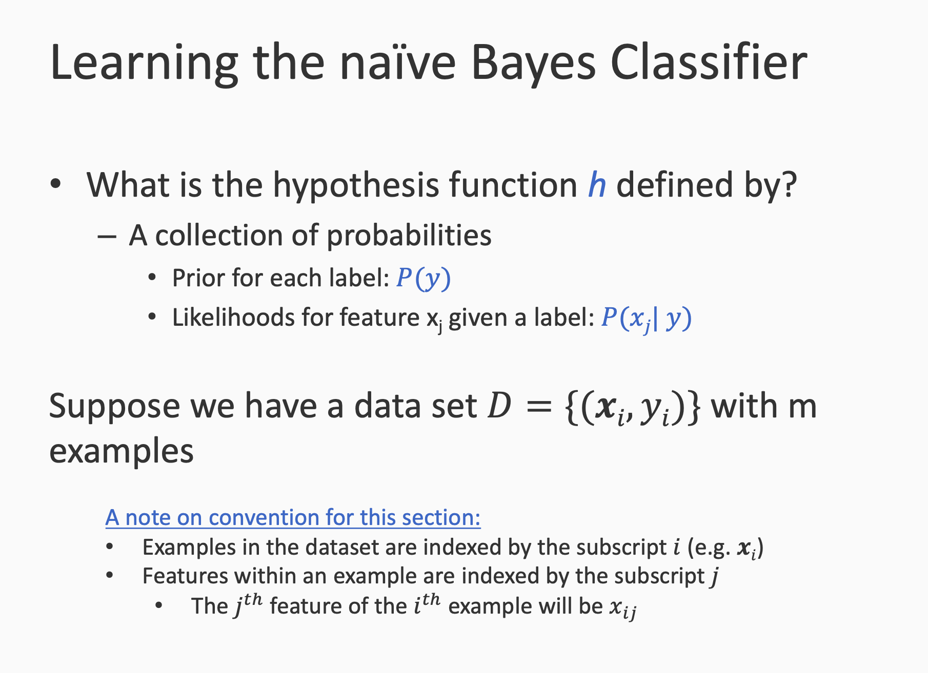

Slide 37
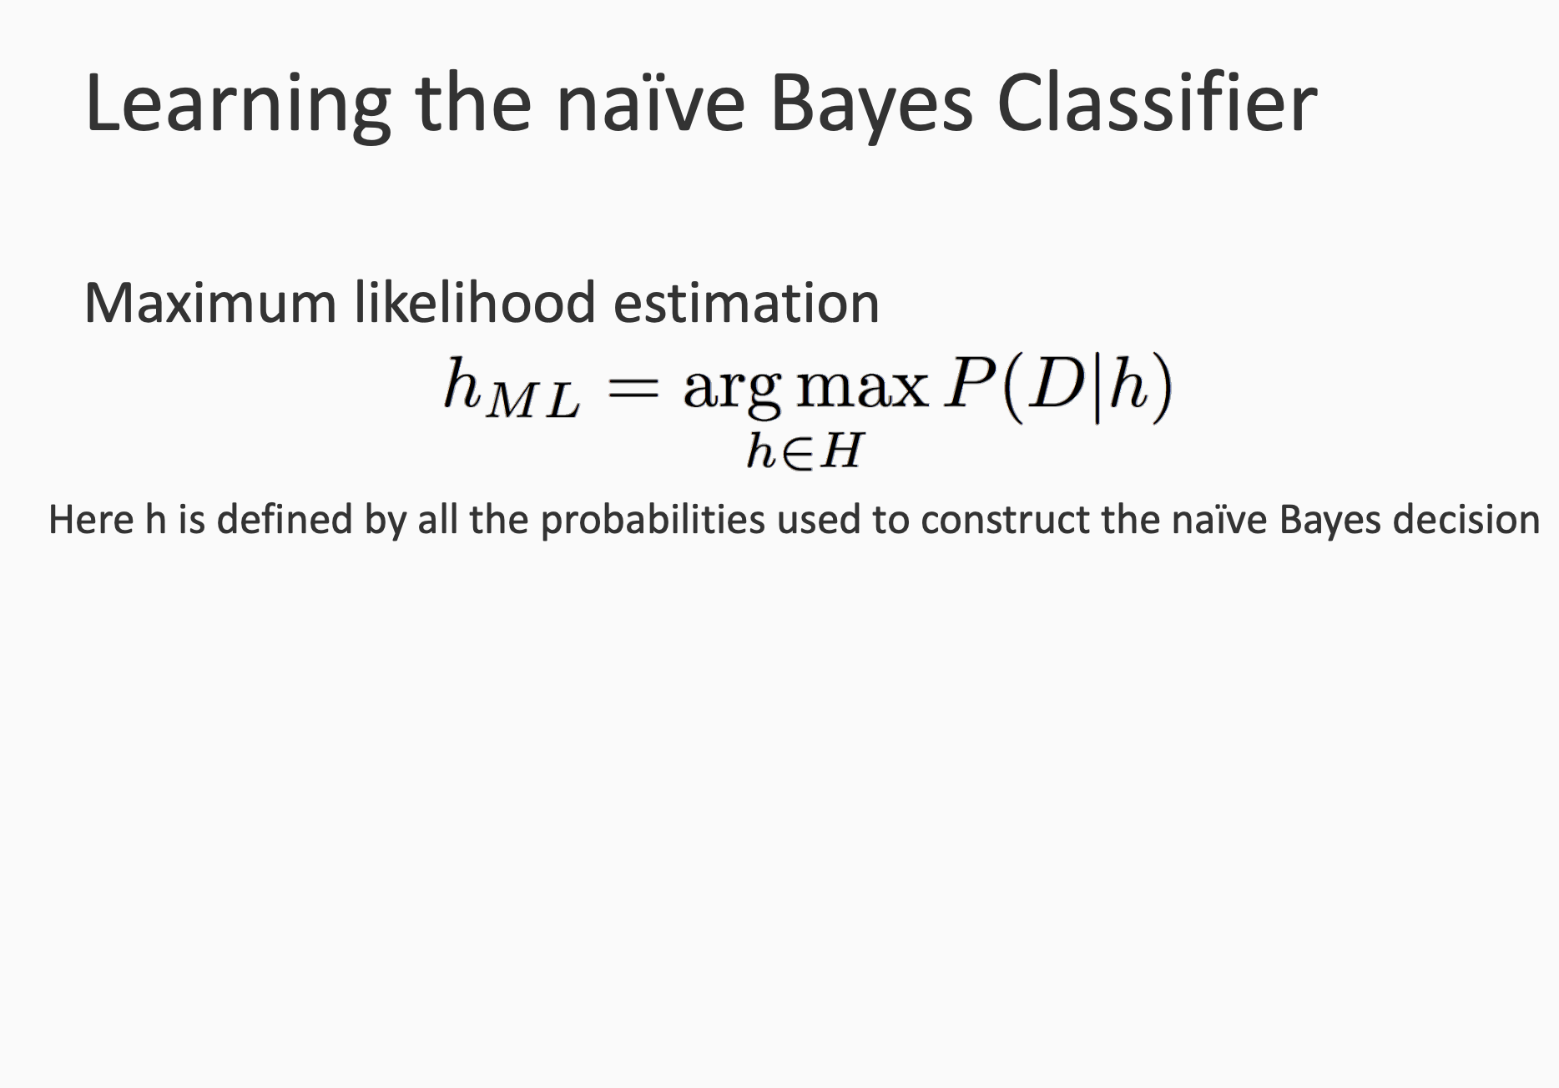

Slide 38
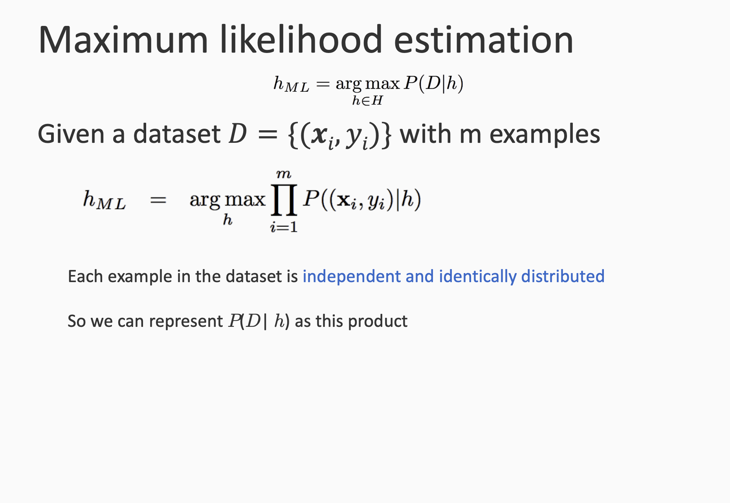
Based on the assumption of IID of dataset

Slide 39
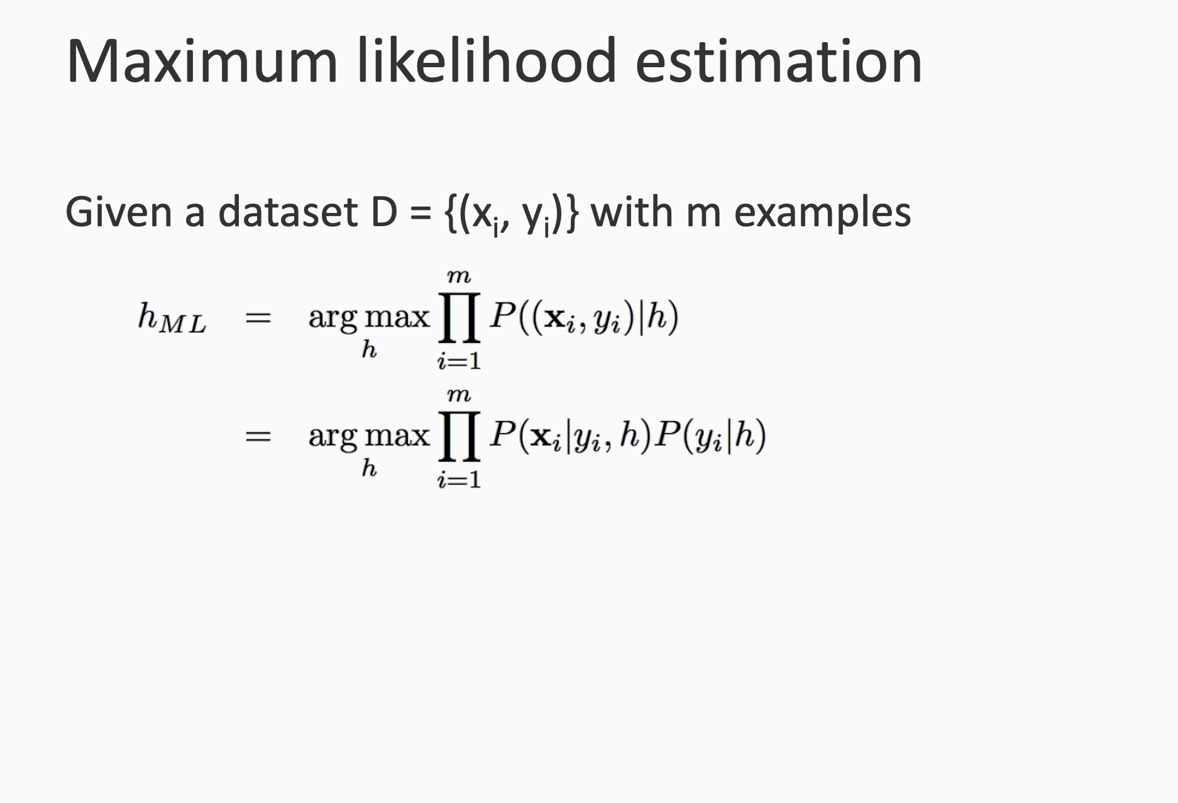
Since: P(a,b) = P(a|b).P(b)

Slide 40
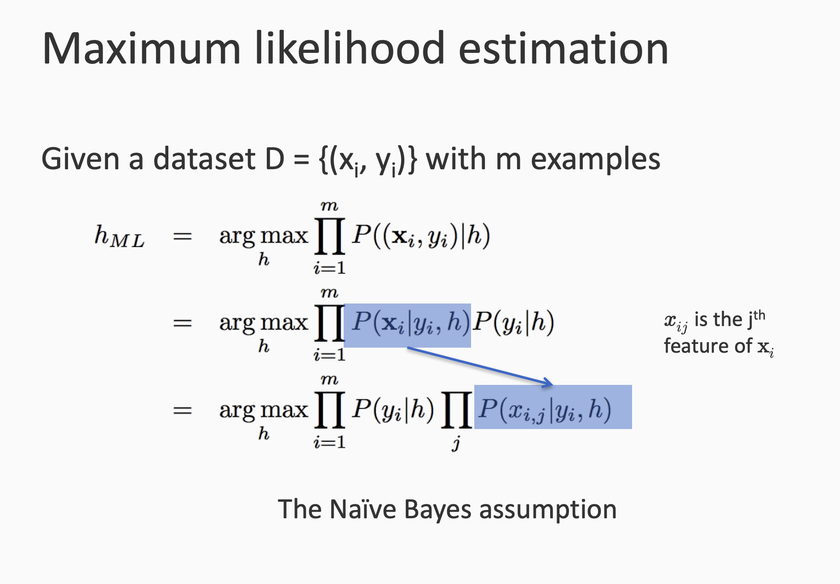
Based on naive assumption

Slide 41
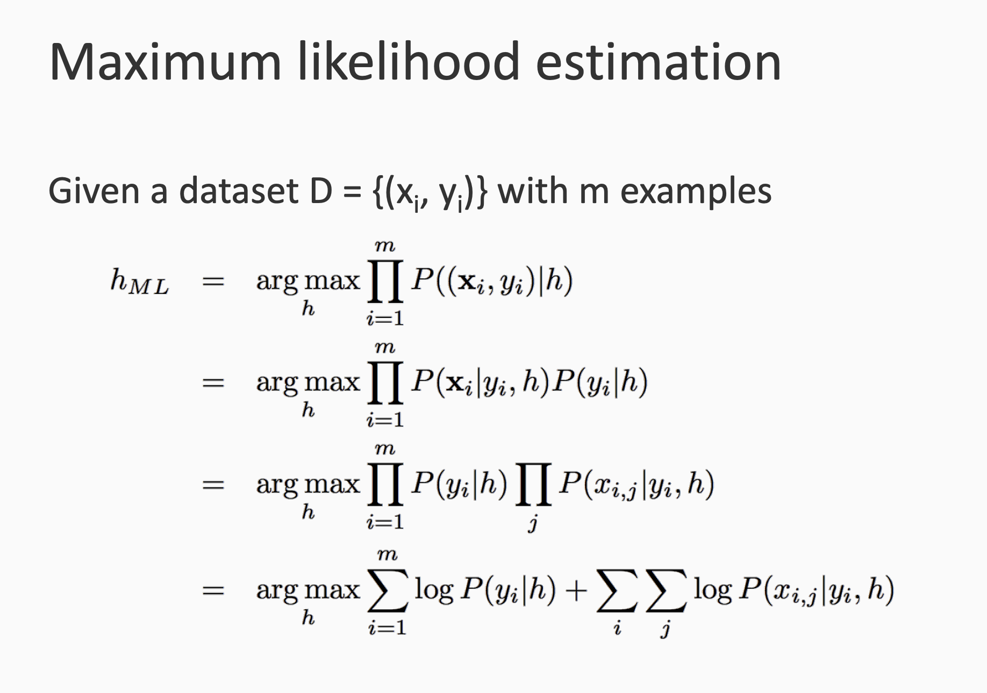

Slide 42
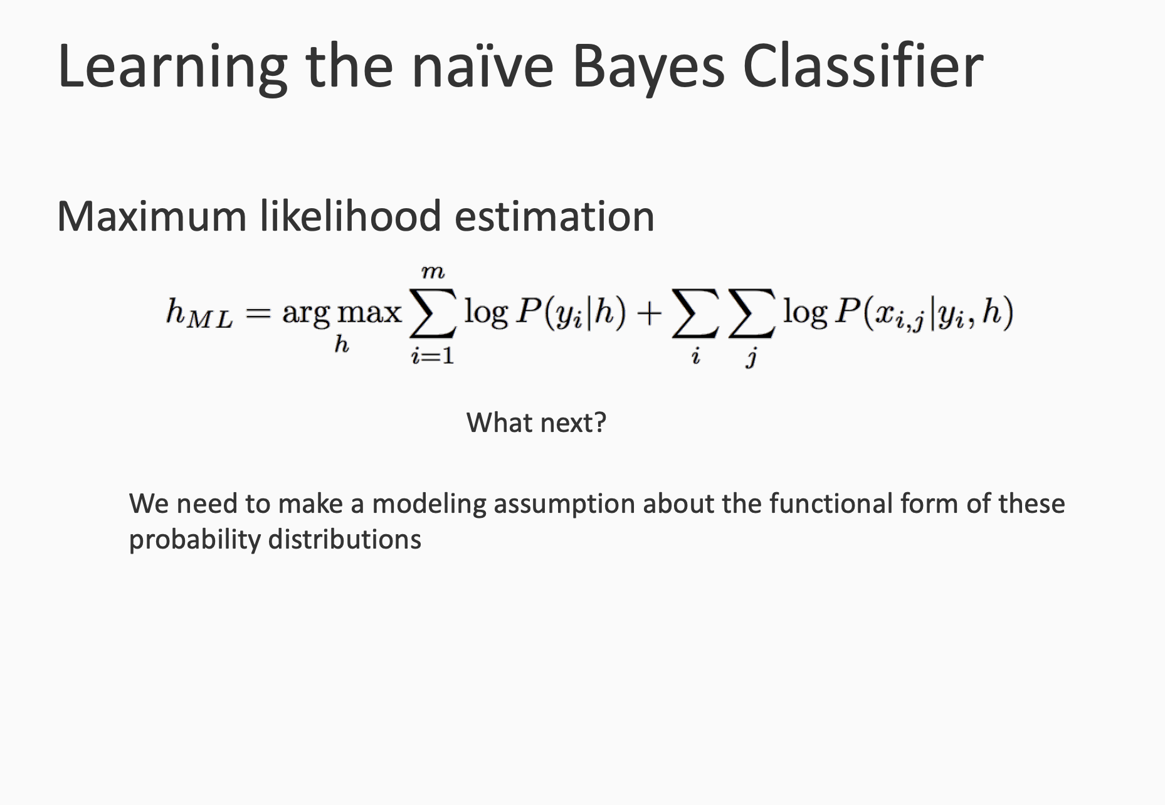

Slide 43
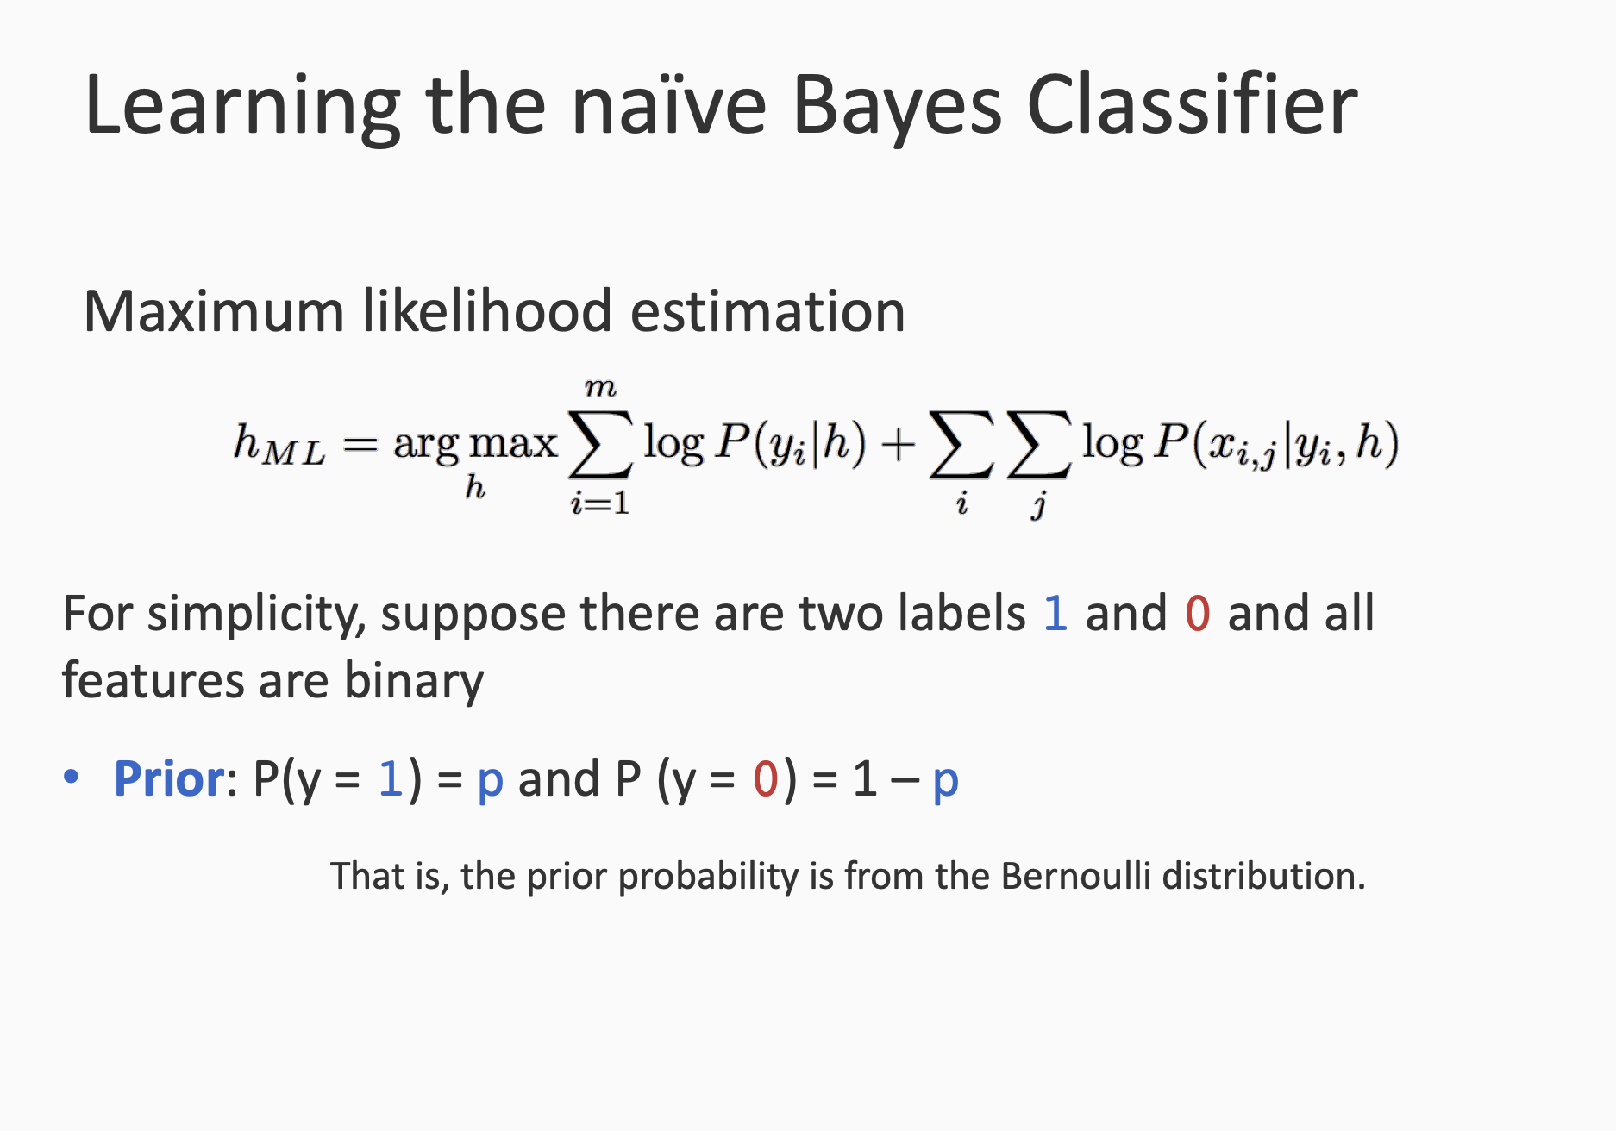

Slide 44
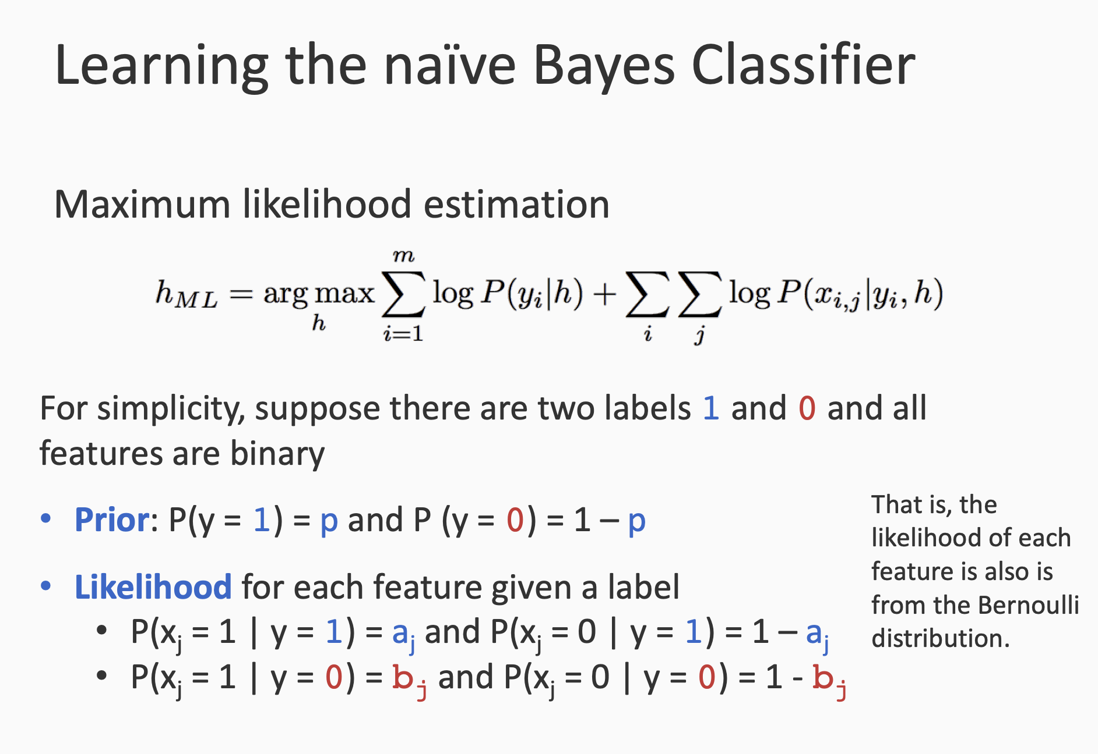

Slide 45
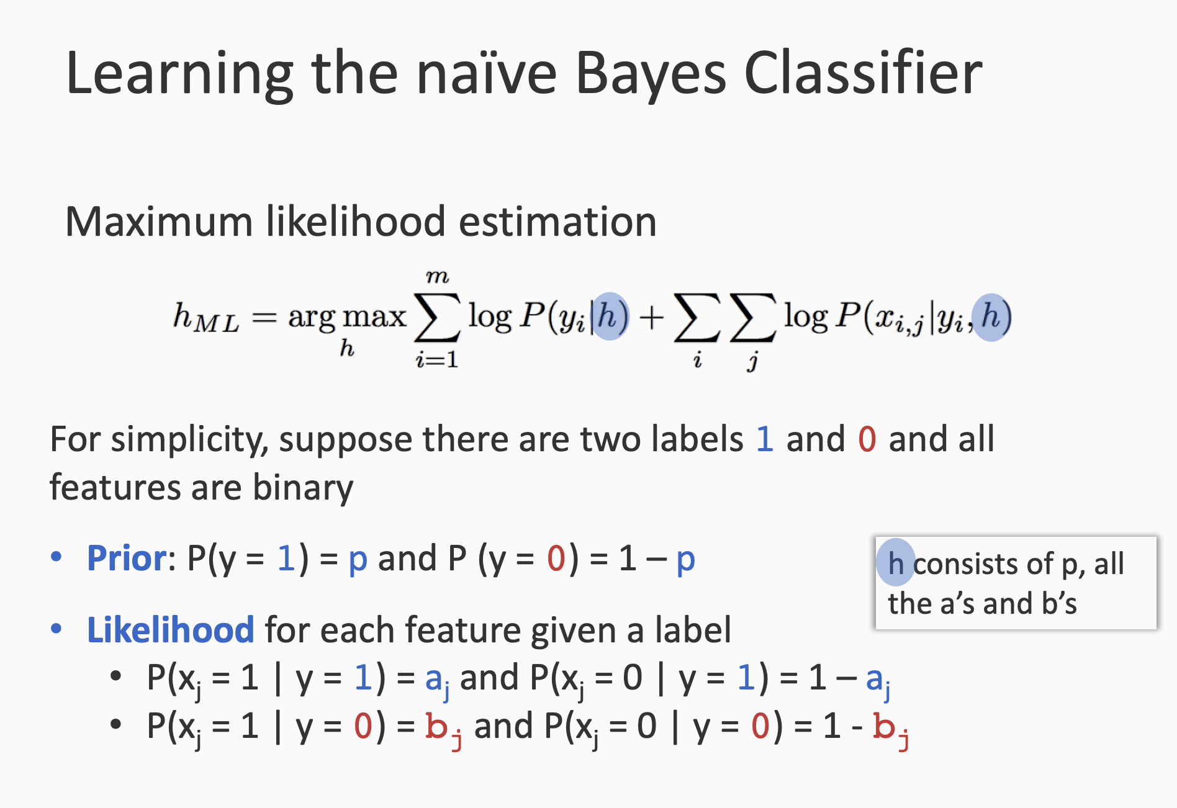

Slide 46
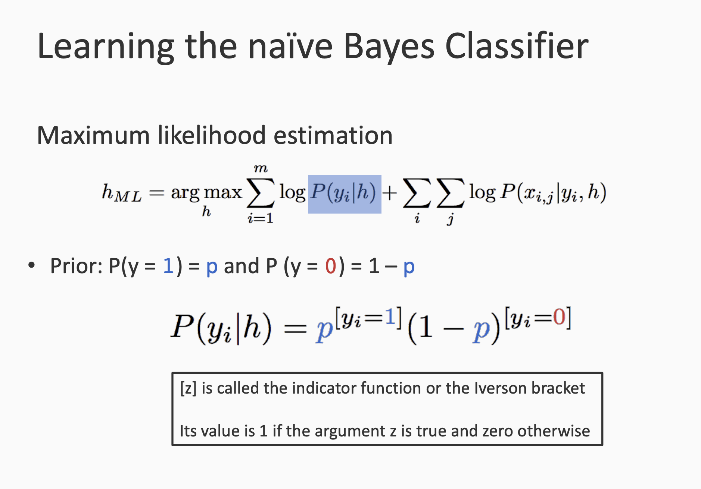

Slide 47
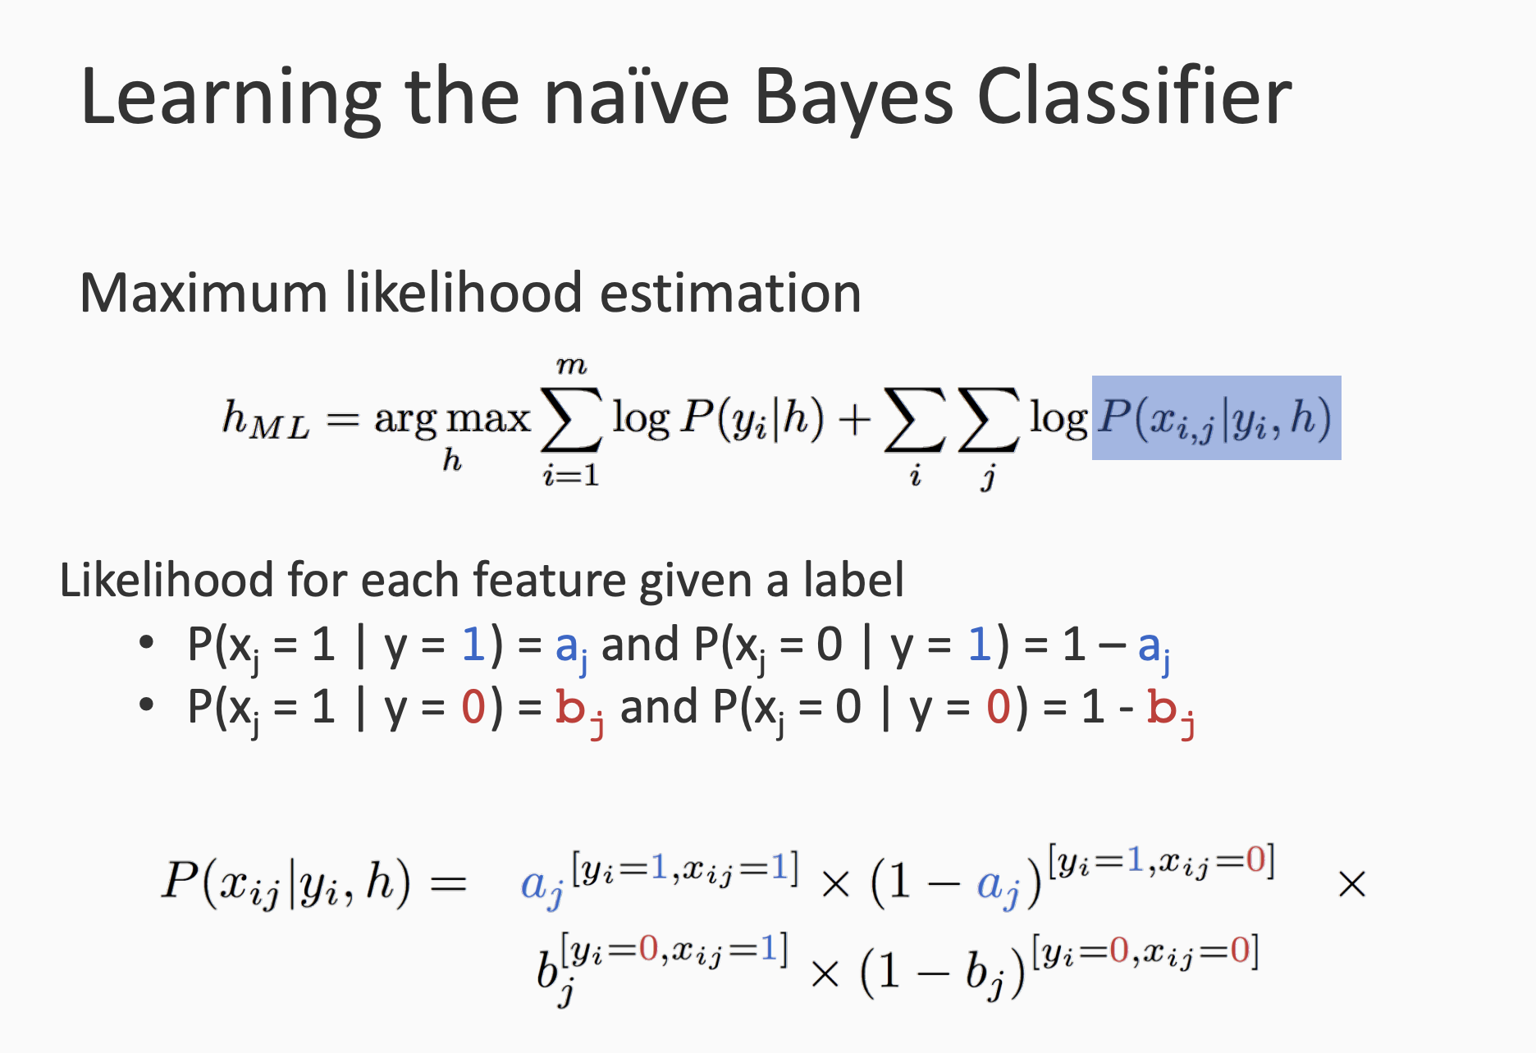

Slide 48
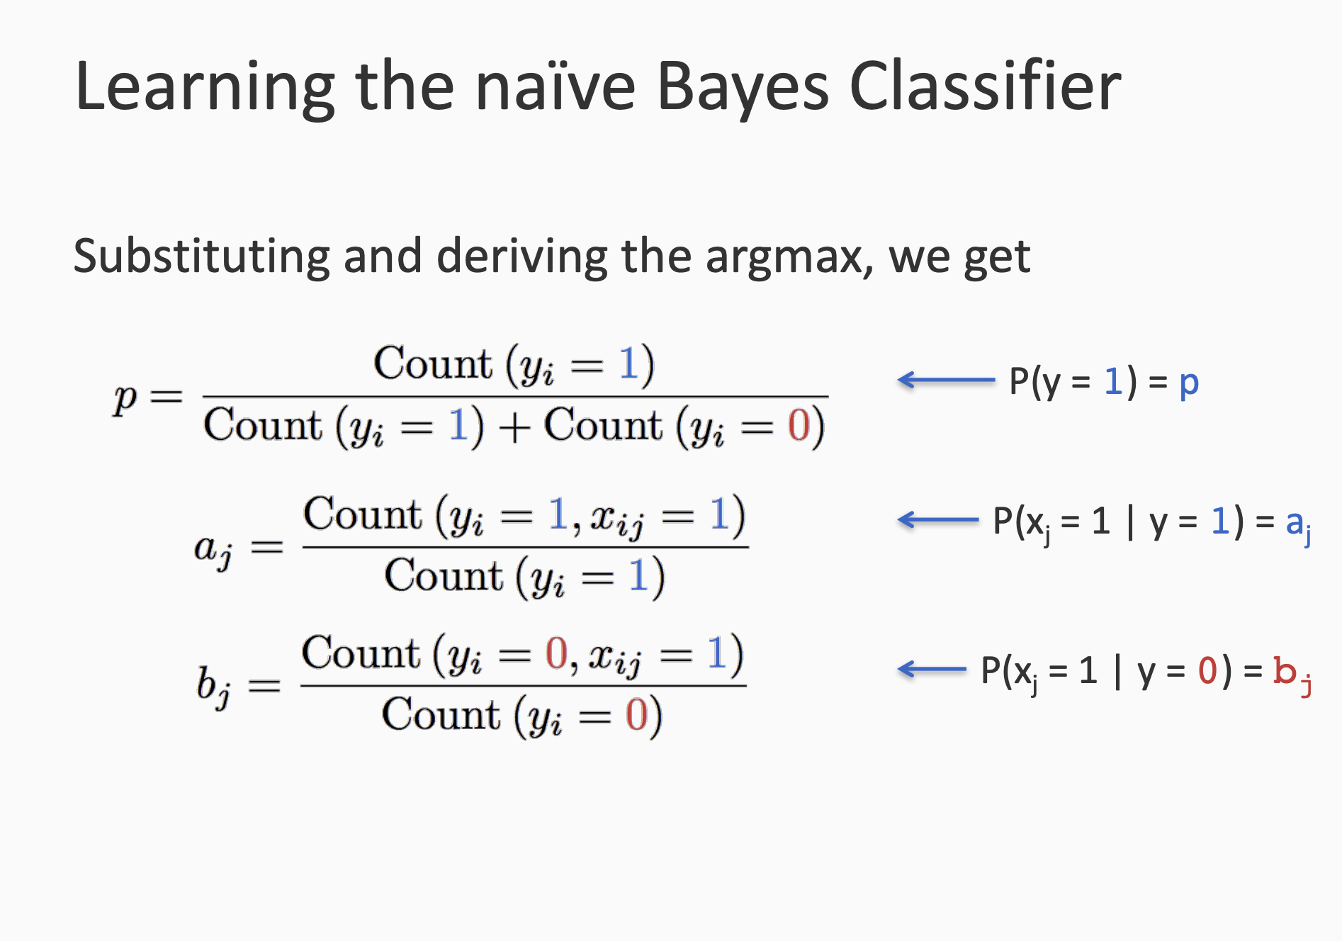

Slide 49
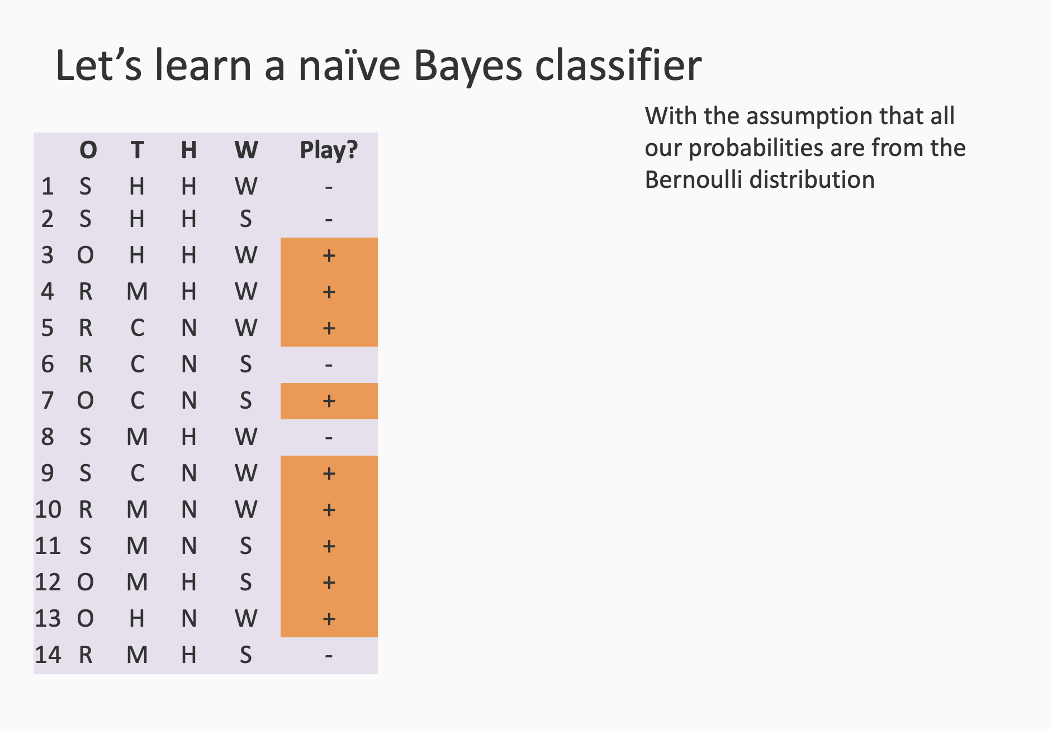

Slide 50
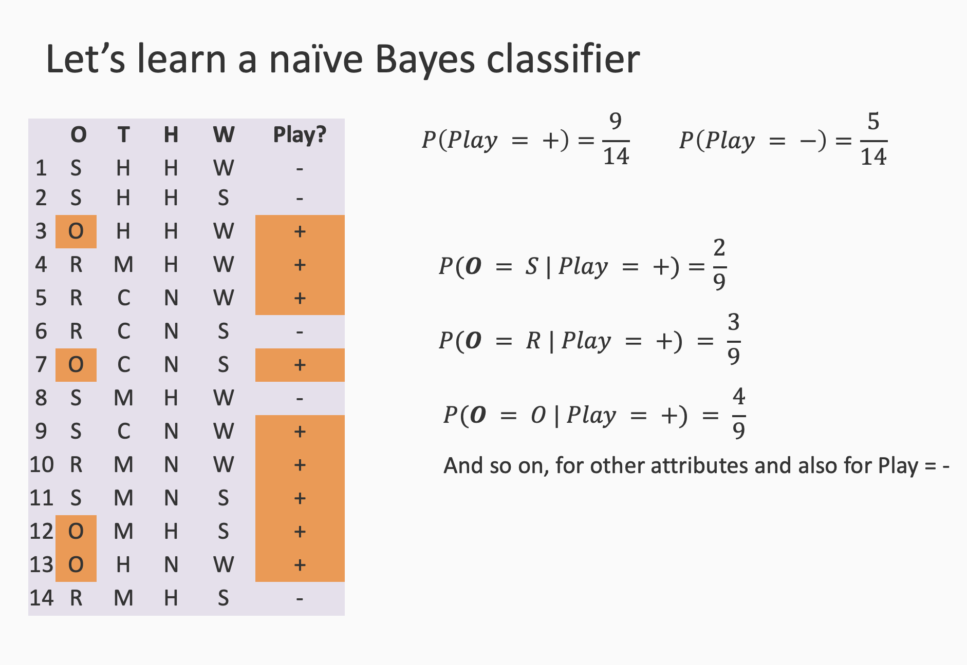
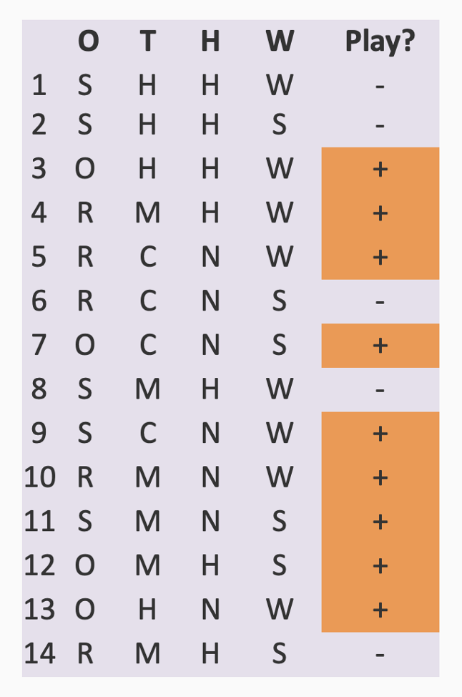
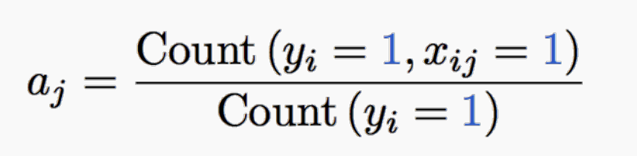

Slide 51
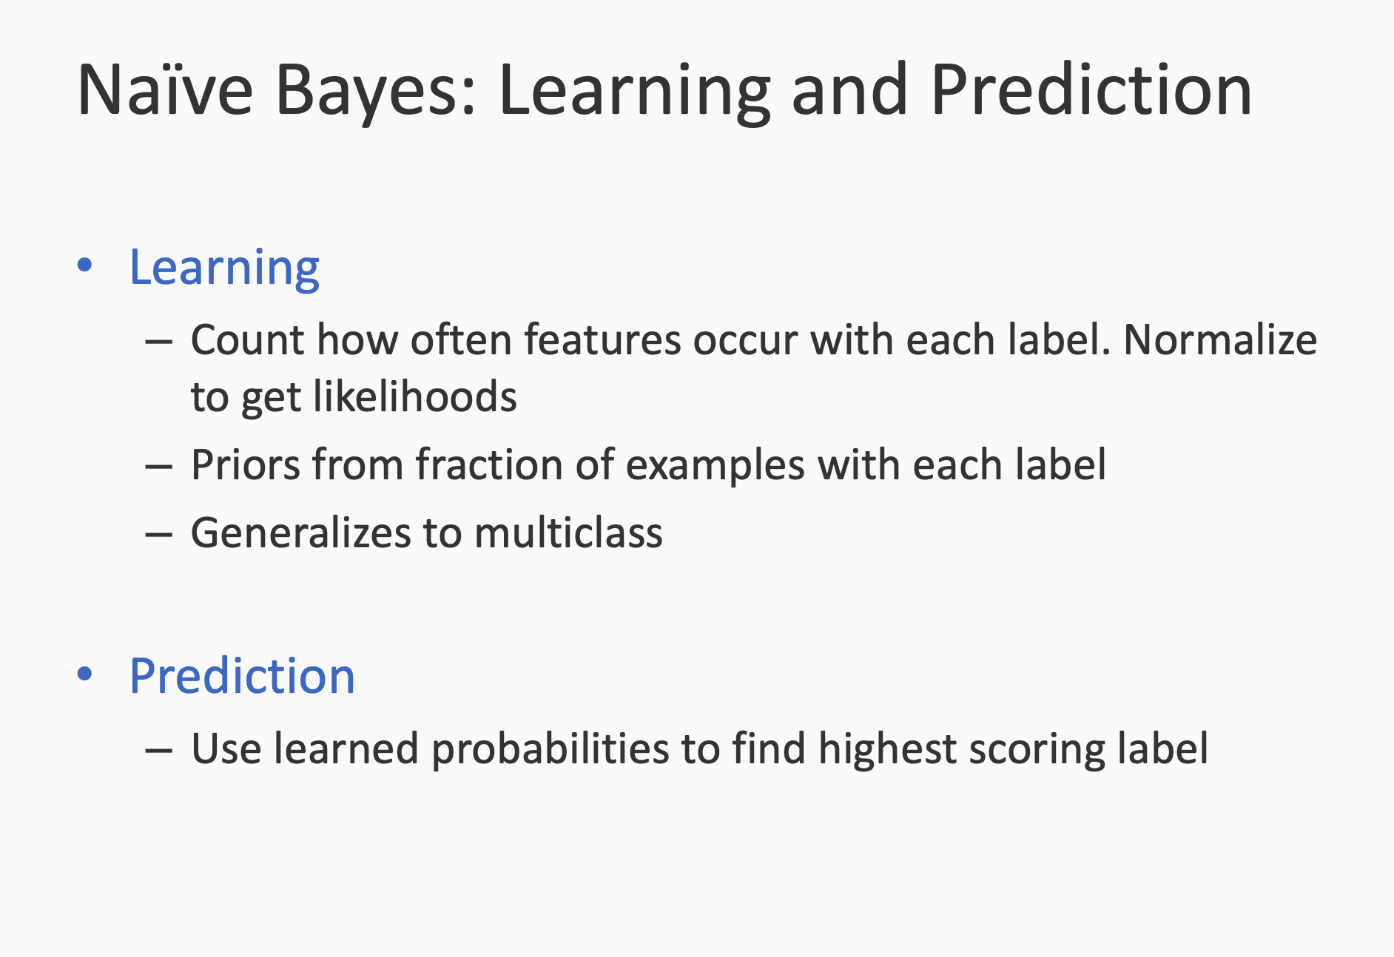

Slide 52
Naive Bayes Caveats

Slide 53
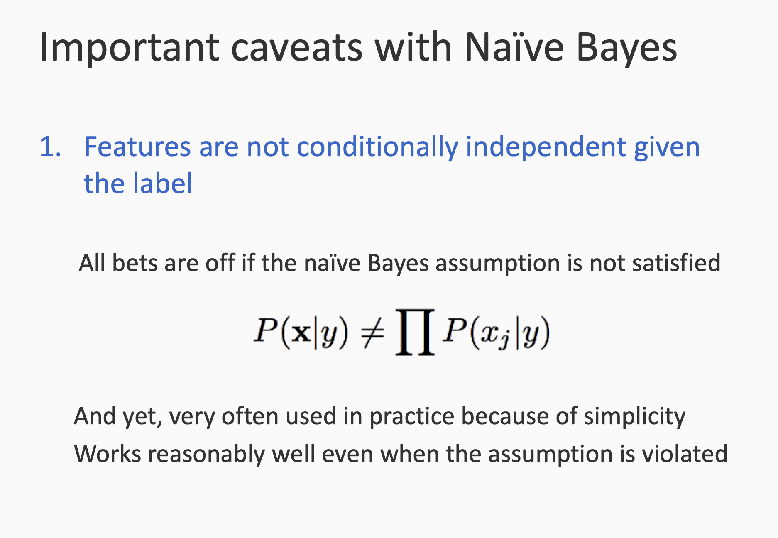

Slide 54
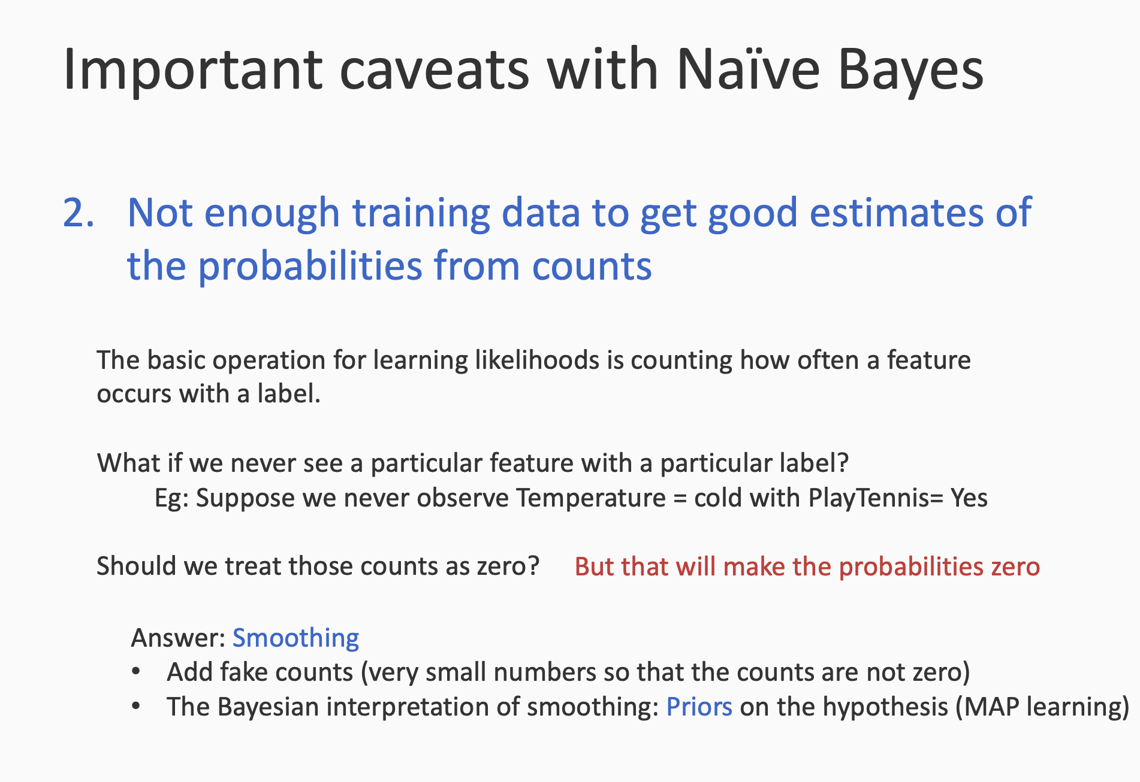

Slide 55
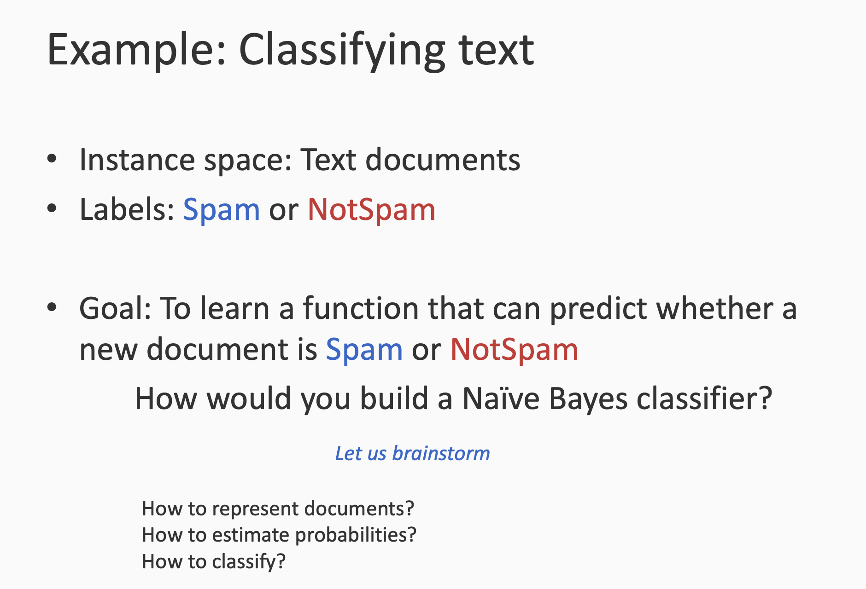

Slide 56
Feature vector for text documents
Document: (I, 300), (am 300) (are, 20) (computer 250)..... →
Feature vector: (300, 300, 20, 250, ....)
Bag of words

Slide 57
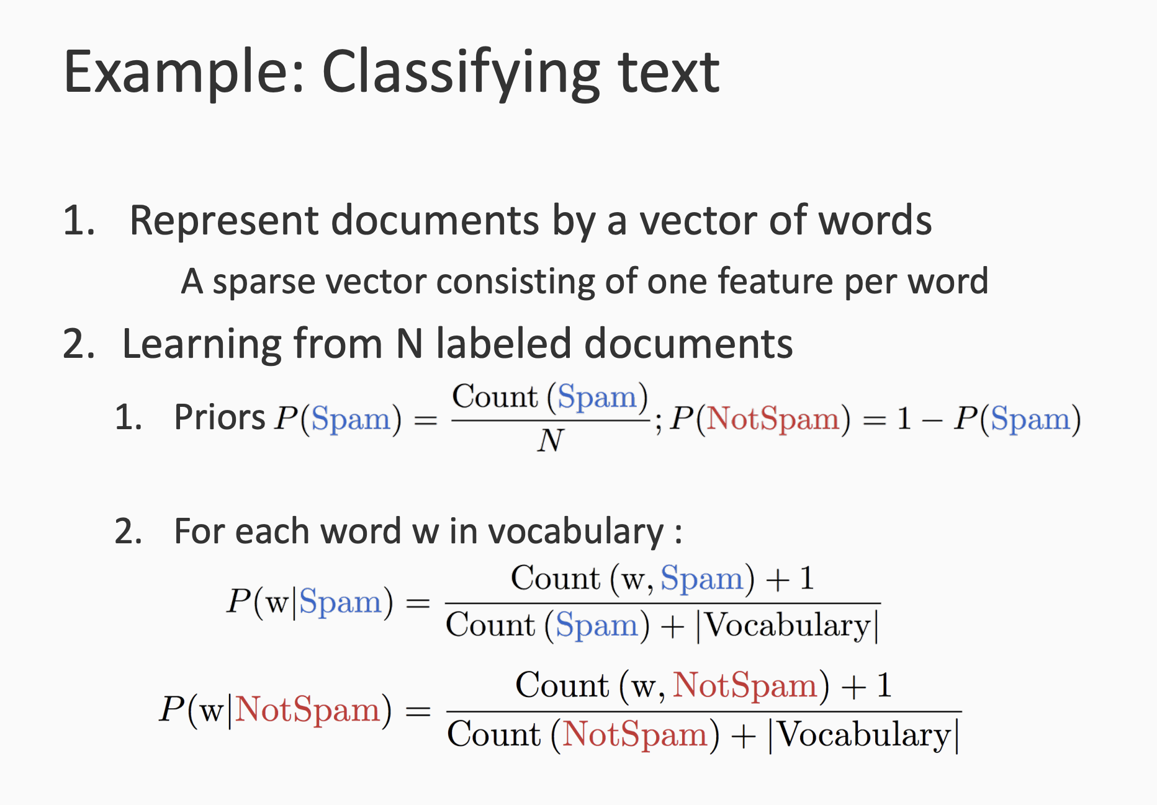

Slide 58
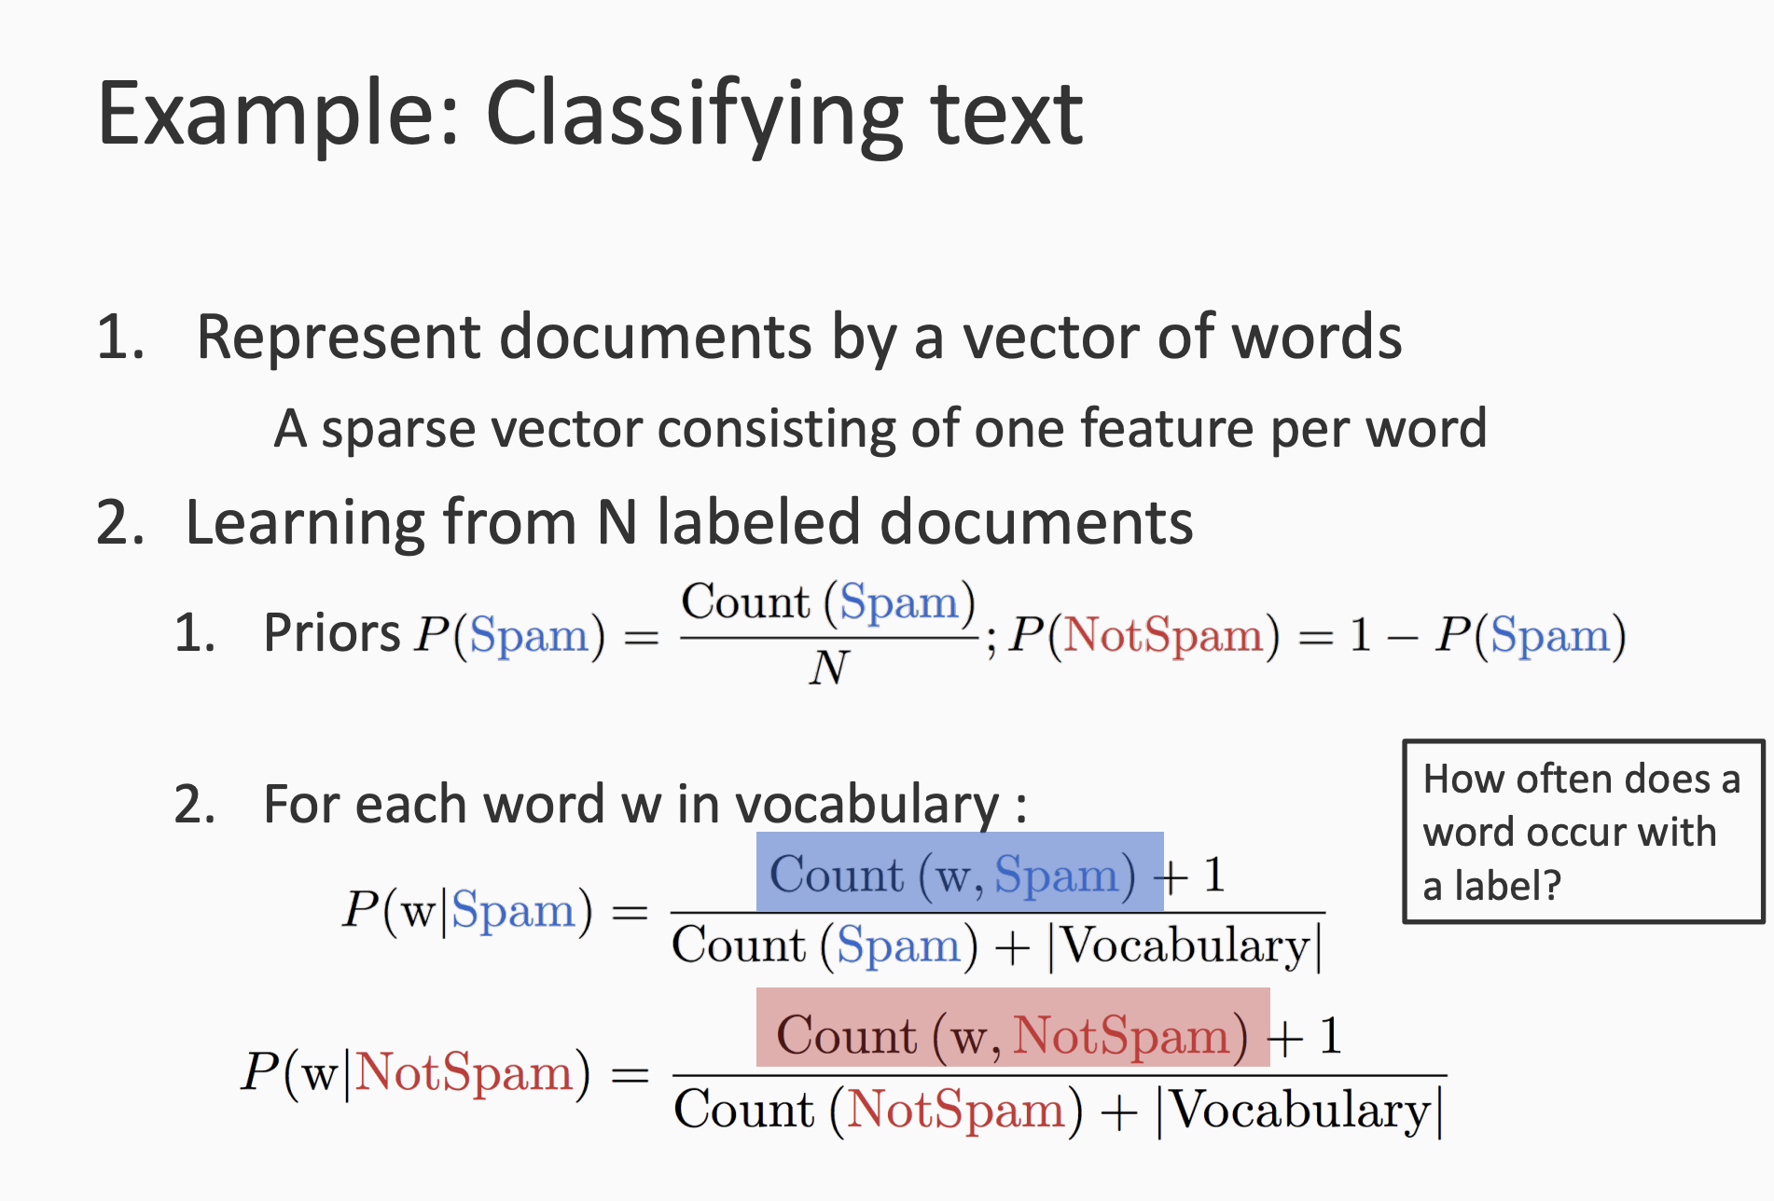

Slide 59
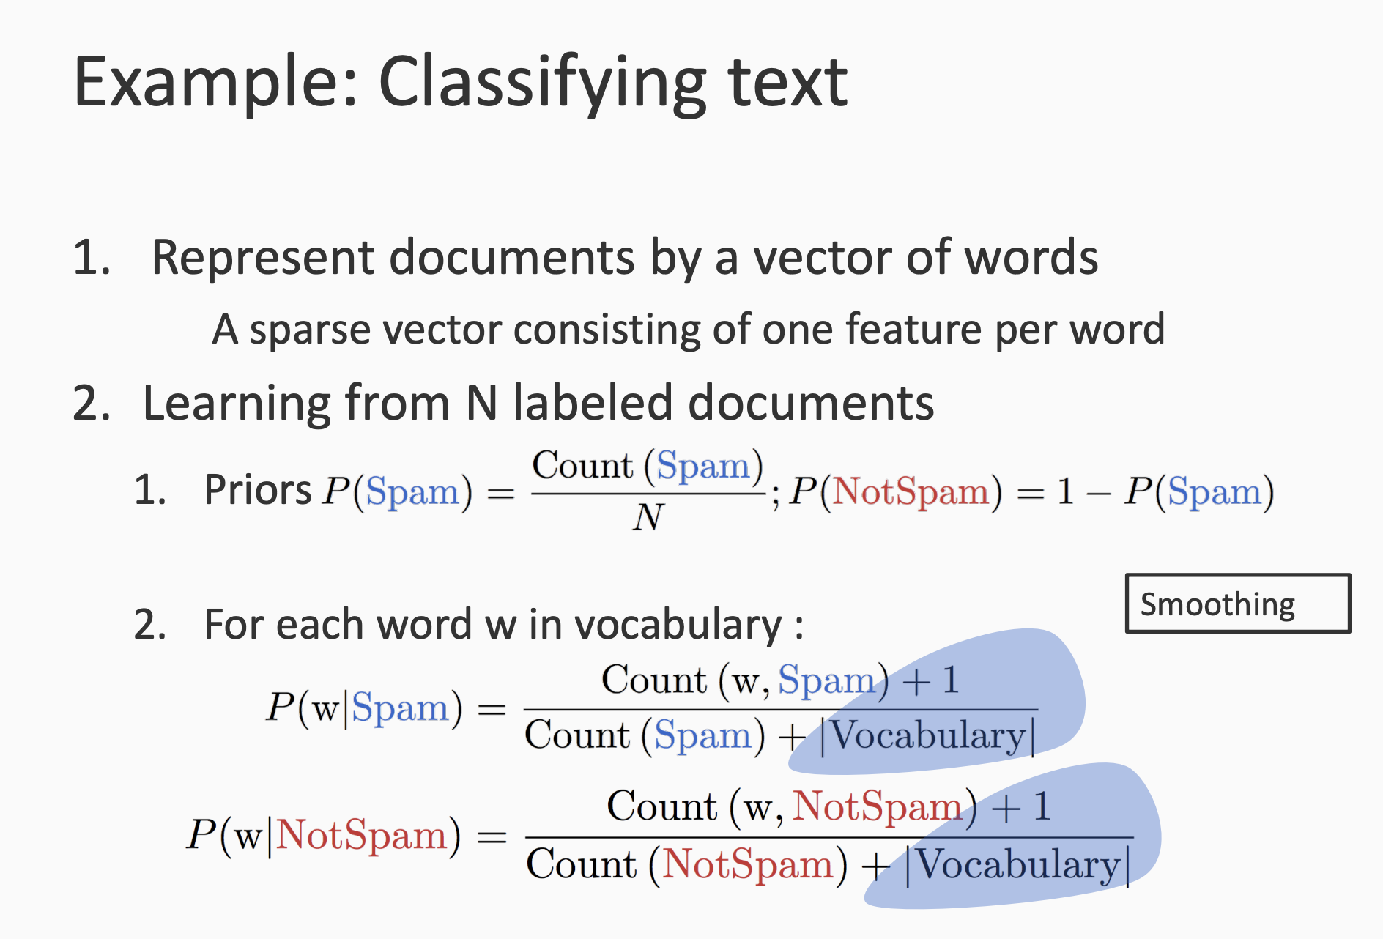

Slide 60
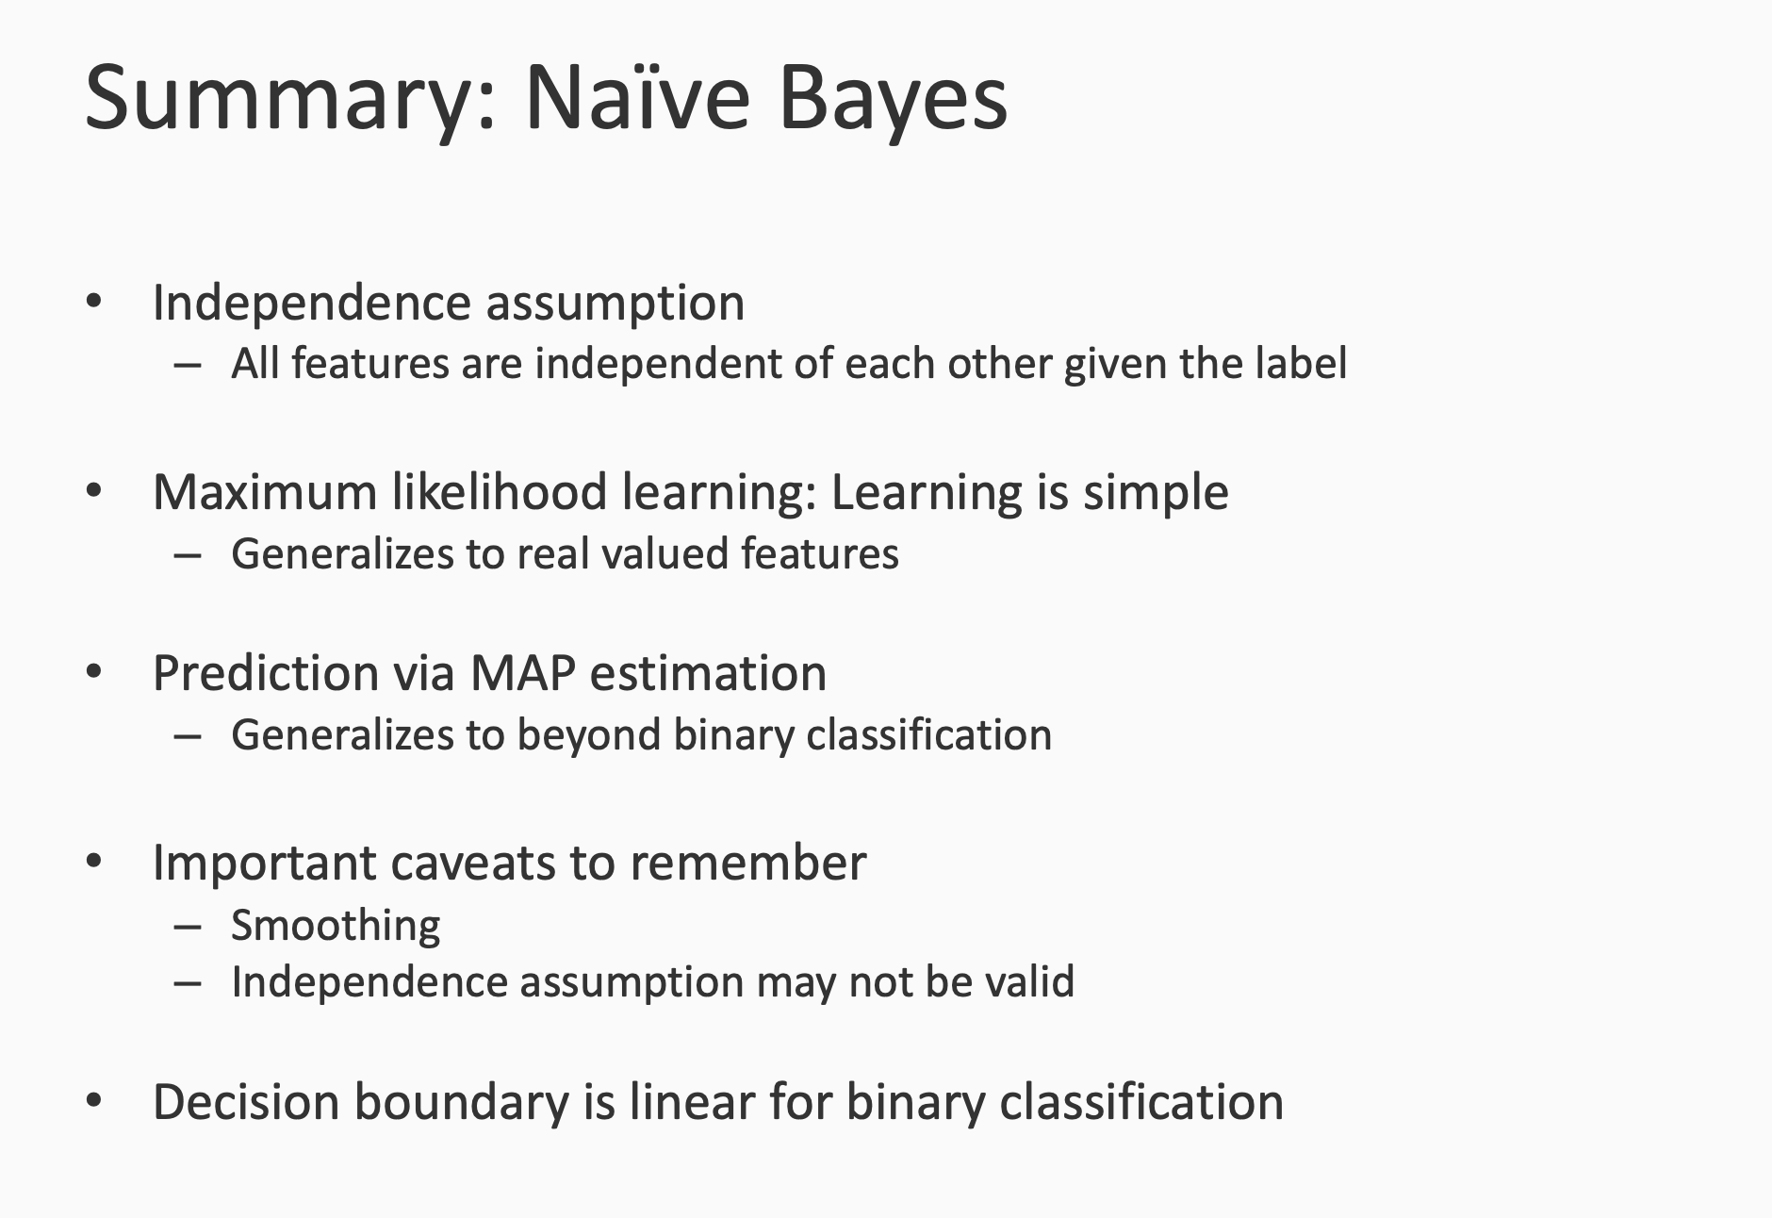
P(y=1|w,x) / P(y=0|w,x) = w^{T}x

Slide 61
References
https://svivek.com/teaching/lectures/slides/prob-learning/probabilistic-learning.pdf
https://svivek.com/teaching/lectures/slides/prob-learning/bayes-optimal-classifier.pdf
https://svivek.com/teaching/lectures/slides/naive-bayes/naive-bayes.pdf

